Slide 1
Thought of the Day
“Gangs don’t protect you; they exploit you and take away your future.
David Lammy MP

Slide 2
Remember to complete all homework tasks on SAM Learning
We still use Classcharts for announcements, surveys and revision material
Homework Club every morning in West Canteen from 8am
Library is open before school and at break times
Students on the following slides have not completed ALL tasks
Make sure you are completing the SET TASKS! These are the tasks your teachers have set.
Notes:
Please give time for the students to produce answers for themselves before showing answers.

Slide 4
Secure your Wellbeing: Learning Journey
Importance of role models
Why is failure a good thing
What is criminal activity?
Dangers of gang culture
Dangers of knife crime
What does your online presence look like?
Today we will look at:
Dangers of gang culture
This includes:
Definition of gangs
Examples of ex gang members
Please remember that during the lesson we should not be asking any pupil or teacher personal questions.
Your teacher can ask you questions but this will be to check your knowledge in the lesson.

Slide 5
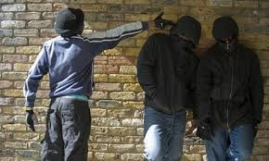
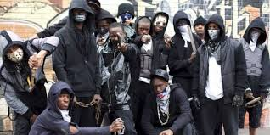
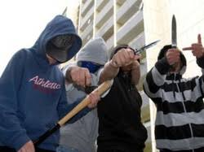
What are gangs?
Gangs are…
“A group of people who come together with a shared identity, often involving illegal activities or antisocial behaviour.”

Slide 6
Why are we learning about this?
This links to the Golden Thread of “Secure your Wellbeing”
Being part of gang may look like a glamourous lifestyle, however it is very dangerous and it can limit your future options as gangs are very difficult to leave

Slide 7
Why are we learning about this?
Rule of Law is a British Value that means everyone is expected to follow the laws. Gangs are heavily involved in illegal activities and antisocial behaviours. This can make communities feel unsafe for everyone else who lives there

Slide 8
Why are we learning about this?
Article 36 states that children have the right to be protected from all kinds of exploitation. Gangs exploit children into joining by giving them things of value. This is not them being nice, this is them not respecting your right of not being exploited. This is because this will become your debt.
UN Rights
of a Child

Slide 9
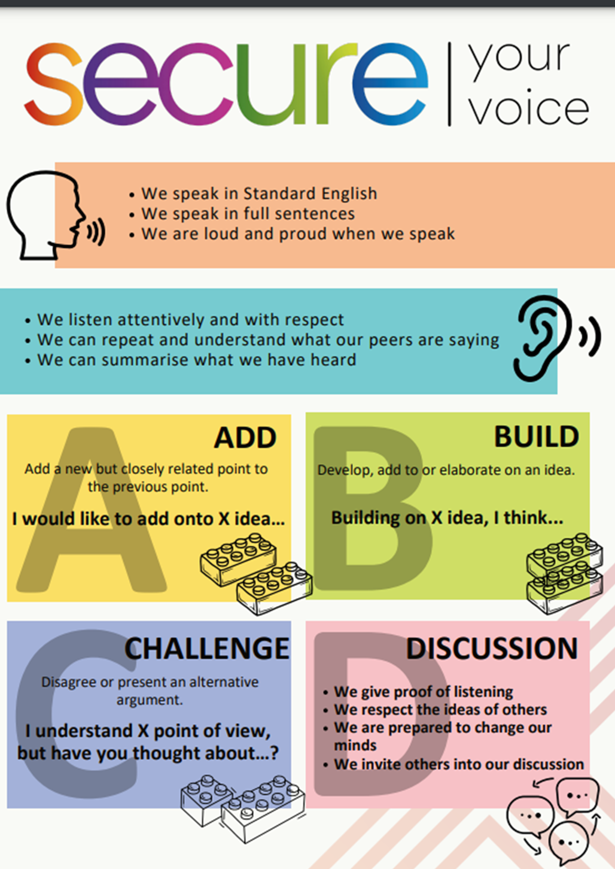
Why people join gangs?
Take out your oracy helpsheet from your learning wallet.
You have 1 minute to think about the following question:
“what do you think people join a gang?”

Slide 10
Why do people join gangs?
Using your oracy helpsheet, with the person next to you, discuss your response to the question:
“what do you think people join a gang?”
Remember to use the sentence starters to add, build or challenge what your partner has said.
Be ready to share your discussion with the class

Slide 11
Why do people join gangs?
People join gangs for many reasons. Some of these reasons are:
For a sense of belonging or identity
Protection
Pressure to join from family or friends
Enjoy risk taking
To get respect
Looking for a glamourous lifestyle
To make lots of money

Slide 12
Video of an ex gang member
Notes:
https://www.youtube.com/watch?v=orCHoamORPc

Slide 13
Gang member example
Take out your oracy helpsheet from your learning wallet.
You have 1 minute to think about the following question:
“Why did this person join a gang? Was it the same reason as the other people in the gang?”

Slide 14
Gang member example
Using your oracy helpsheet, with the person next to you, discuss your response to the question:
“Why did this person join a gang? Was it the same reason as the other people in the gang?”
Remember to use the sentence starters to add, build or challenge what your partner has said.
Be ready to share your discussion with the class

Slide 15
Video of an ex gang member
Notes:
https://www.youtube.com/watch?v=emUQLDd5syw

Slide 16
Gang member example
Take out your oracy helpsheet from your learning wallet.
You have 1 minute to think about the following question:
“What do you think is the main learning point from this person’s story?”

Slide 17
Gang member example
Using your oracy helpsheet, with the person next to you, discuss your response to the question:
“What do you think is the main learning point from this person’s story?”
Remember to use the sentence starters to add, build or challenge what your partner has said.
Be ready to share your discussion with the class

Slide 18
Gangs
You will be learning much more about gangs including their structure and discussing the county lines gangs in your Personal Development lesson this week.

Slide 19
Support
If you ever need support about gangs for yourself, a friend or family member you can find it here:
Childline.org.uk
Call – 08001111
Email or chat online for support
Themix.org.uk
You can email or have one-to-chat online.
There is also a crisis messenger which is available 24/7

