Slide 1
Remember to complete all homework tasks on SAM Learning
We still use Classcharts for announcements, surveys and revision material
Homework Club every morning in West Canteen from 8am
Library is open before school and at break times
Students on the following slides have not completed ALL tasks
Make sure you are completing the SET TASKS! These are the tasks your teachers have set.
Notes:
Please give time for the students to produce answers for themselves before showing answers.

Slide 3
Thought of the Day
“Eating disorders are serious mental illnesses, they are not a lifestyle choice or a diet gone wrong”

Slide 4
Secure your Wellbeing: Learning Journey
What is mental health?
Impact of drugs and alcohol on mental health
What is gambling?
What are eating disorders?
How to deal with emotions?
How to deal with fallouts
Today we will look at:
What are eating disorders?
This includes:
Definition of gambling
Different types of gambling
Please remember that during the lesson we should not be asking any pupil or teacher personal questions.
Your teacher can ask you questions but this will be to check your knowledge in the lesson.

Slide 5
Why are we learning about this?
Learning about eating disorders will help secure your wellbeing.
Knowing the different types of eating disorders and the symptoms can help a person get help earlier and start the journey to keep the condition in check or make a full recovery

Slide 6
Why are we learning about this?
Health and food are referenced in numerous articles in the UN Right of a Child. This is because to be the best possible version of yourself, consuming enough food and healthy food is essential for the body and mind to work and to remain healthy.
UN Rights
of a Child

Slide 7
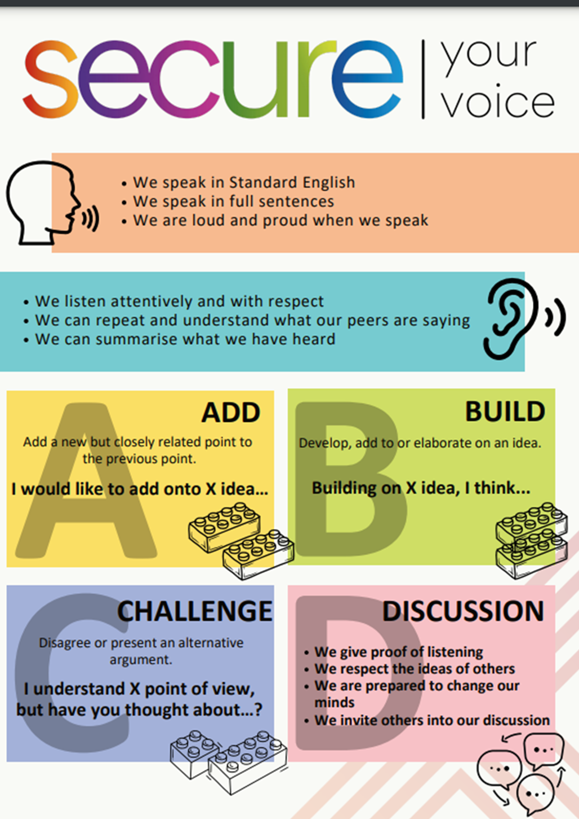
What are eating disorders?
Take out your oracy helpsheet from your learning wallet.
You have 1 minute to think about the following question:
“What are eating disorders? Have you heard of this term before?”

Slide 8
What are eating disorders?
Using your oracy helpsheet, with the person next to you, discuss your response to the question:
“What are eating disorders? Have you heard of this term before?”
Remember to use the sentence starters to add, build or challenge what your partner has said.
Be ready to share your discussion with the class

Slide 9
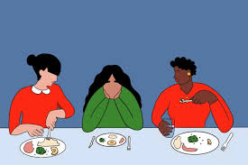
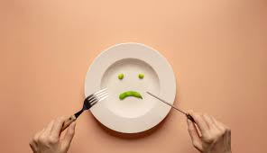
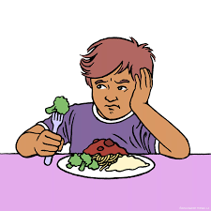
What are eating disorders?
Eating disorders are…
“mental health conditions where people have an unhealthy focus on food, body weight or shape”

Slide 10
What are eating disorders?
Eating disorders affect a person’s emotions, behaviours and physical health.
Unfortunately eating disorders are common and affect many young people.
Learning and understanding eating disorders can help people find support to combat the eating disorder.

Slide 11
What are eating disorders?
There are lots of myths about eating disorders.
For each of the following statements decide if you think it is a myth or fact.

Slide 12
What are eating disorders?
Is the following statement a myth or fact.
“eating disorders only happen to girls”
This is a myth. Eating disorders affect people of all genders.

Slide 13
What are eating disorders?
Is the following statement a myth or fact.
“eating disorders are not only about food, they also include weight and body shape”
This is a fact. Eating disorders are often tied to how people feel about themselves which is commonly weight and body size.

Slide 14
What are eating disorders?
Is the following statement a myth or fact.
“eating disorders are dangerous”
This is a fact. Eating disorders can lead to serious physical health issues.

Slide 15
What are eating disorders?
Is the following statement a myth or fact.
“people with eating disorders are just looking for attention”
This is a myth. Eating disorders are not attention seeking behaviours but serious conditions that require empathy and understanding

Slide 16
What are eating disorders?
Is the following statement a myth or fact.
“you can tell if someone has an eating disorder just by looking at them”
This is a myth. You can’t always tell by appearance as eating disorders are all very different

Slide 17
Support
If you ever need support about eating disorders for yourself, a friend or family member you can find it here:
Childline.org.uk
Call – 08001111
Email or chat online for support
Themix.org.uk
You can email or have one-to-chat online.
There is also a crisis messenger which is available 24/7

