Slide 1
Remember to complete all homework tasks on SAM Learning
We still use Classcharts for announcements, surveys and revision material
Homework Club every morning in West Canteen from 8am
Library is open before school and at break times
Students on the following slides have not completed ALL tasks
Make sure you are completing the SET TASKS! These are the tasks your teachers have set.
Notes:
Please give time for the students to produce answers for themselves before showing answers.

Slide 2
Abdulaahi, Khalid
Ali, Laith
Hersi, Maher
Ibrar, Malika
Jan, Maryam
Adeyera, Maxwell
Asif, Maya
Khaouader, Maysam
Ali, Miya
Abbas, Mohammed
Adam, Mohammed
Esa, Mohammed
Ibraheem, Mohammed
Ibrahim, Mohammed
Jatoi, Muhammad
Rayees, Muhammed Ayaan
Aden, Mustafa
Ali, Mustafa
Sikander, Rehan
Anjum, Rimsha
Mahmood, Sami
Hondar, Samuel
Hussain, Sehrish
Akanji, Shadiyah
Suleman, Shayaan
Hussain, Summayah
Khan, Summayah
Hussain, Umar
Rehman, Yaseen
Tabassum, Yousaf
Ikhlaq, Yusuf
Imran, Yusuf
Nasir, Zaid
Jahanzeb, Subhan
Maria, Miakhel
Haroon, Hashim
Nadeem, Saif
Zaman, Aahil
Zaman, Abdullah
Ali, Abdullahi
Asad, Aleena
Ahmed, Aleeza
Sikandar, Alisha
Diop, Alpha
Islam, Amelia
Rahman, Amelia
Shimbar, Amir
Ansar, Amiyrah
Adebowale, Awwal
Ali, Ayaan
Khan, Ayaan
Nafees, Ayaan
Meadley, Bella
Farooq, Eisa
Raja, Esa
Fareedi, Fareed
Bashir, Farhan
Ehsan, Farhan
Mane, Fode
Shakil, Hafsah
Hussain, Haider
Riaz, Haider
Aqeel, Hamzah
Rahman, Hamzan
Arif, Hanzalah
Iqbal, Hasan
Perviz, Husain
Sadiq, Ibraheem
Hussain, Ibrahim
Shah, Ibrahim
Tashfin, Ibrahim
Aamar, Isa
Spinks, Jack
Davis-Kerr, Jaden
Rodney, Kaiden
Following students have not competed their Maths Homework that is due on Monday 21ST October. This needs to be completed as soon as possible and all other set tasks.
Students will be put into a detention if they continue to not complete homework and phone calls will be made to parents.

Slide 4
Thought of the Day
“What mental health needs is more sunlight, more candor, and more unashamed conversation”
Glenn Close

Slide 6
Secure your Wellbeing: Learning Journey
What is mental health?
Impact of drugs and alcohol on mental health
What is gambling?
What are eating disorders?
How to deal with emotions?
How to deal with fallouts
Today we will look at:
What is mental health?
This includes:
Definition of mental health?
Difference between mental health and mental illness
Ways to improve mental health?
Please remember that during the lesson we should not be asking any pupil or teacher personal questions.
Your teacher can ask you questions but this will be to check your knowledge in the lesson.

Slide 7
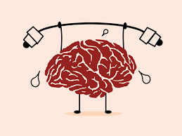
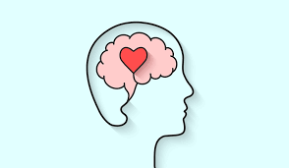
What is mental health?
With the person next to you discuss the following question
“what is mental health?”
Be ready to share your answers with the class

Slide 8
What is mental health?
The World Health Organisation (WHO) say…
“mental health is a state of mental well being that enables people to cope with the stresses of life, realise their abilities, learn well and work well and contribute to their community”

Slide 9
What is mental health?
Mental health is not just when people are feeling down. People have mental health when they are feeling good.
Mental health is something everyone has and it impacts everyone, everyday.

Slide 10
What is mental health?
Notes:
https://www.youtube.com/watch?v=DxIDKZHW3-E play from beginning to 4.50

Slide 11
What is the difference between mental health and mental illness?
People often confuse mental health and mental illness.
Everyone has mental health but not everyone has mental illness
Mental illness can include things like depression, eating disorders, mood disorders and anxiety. These things affect a persons ability to function over a long period of time. They also need to be diagnosed by a trained professional.
When a person is suffering from poor mental health one day, it does not mean that they have a mental illness. This is because it is not over a long period of time.

Slide 12
How to have good mental health
Studies have shown that there are a number of things that can help you have good mental health.
With the person next to you discuss what these might be.

Slide 13
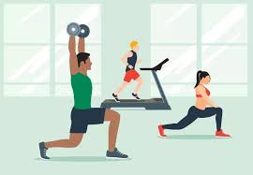
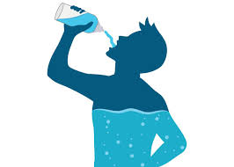
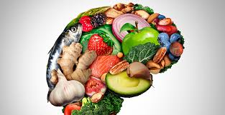
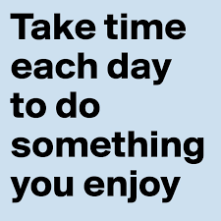
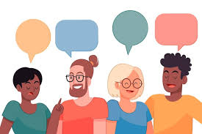
How to have good mental health
Studies have shown that there are a number of things that can help you have good mental health.
Exercise
Stay hydrated
Eat healthy food
Do things that make you happy
Speak to people in person to feel connected. Speaking online is not as effective

Slide 14
Support
If you ever need support about mental health for either yourself or a friend/family member, you can get support from the following places
Childline.org.uk
Call – 08001111
Email or chat online for support
Themix.org.uk
You can email or have one-to-chat online.
There is also a crisis messenger which is available 24/7

