Slide 2
Thought for the Day
“Taking action when it comes to STIs isn’t just about protecting yourself, it’s about protecting those you care about too”
Dr Gail Bolan

Slide 4
Secure your Future: Learning Journey
Impact of the media on relationships
What is consent in romantic relationships
What is the impact of pornography?
What is sexting and the law?
What is contraception
What are STI’s?
Today we will look at:
What are STI’s?
This includes:
What are STI’s?
What STI’s do you know?
Facts and myths about STI’s
Please remember that during the lesson we should not be asking any pupil or teacher personal questions.
Your teacher can ask you questions but this will be to check your knowledge in the lesson.

Slide 5
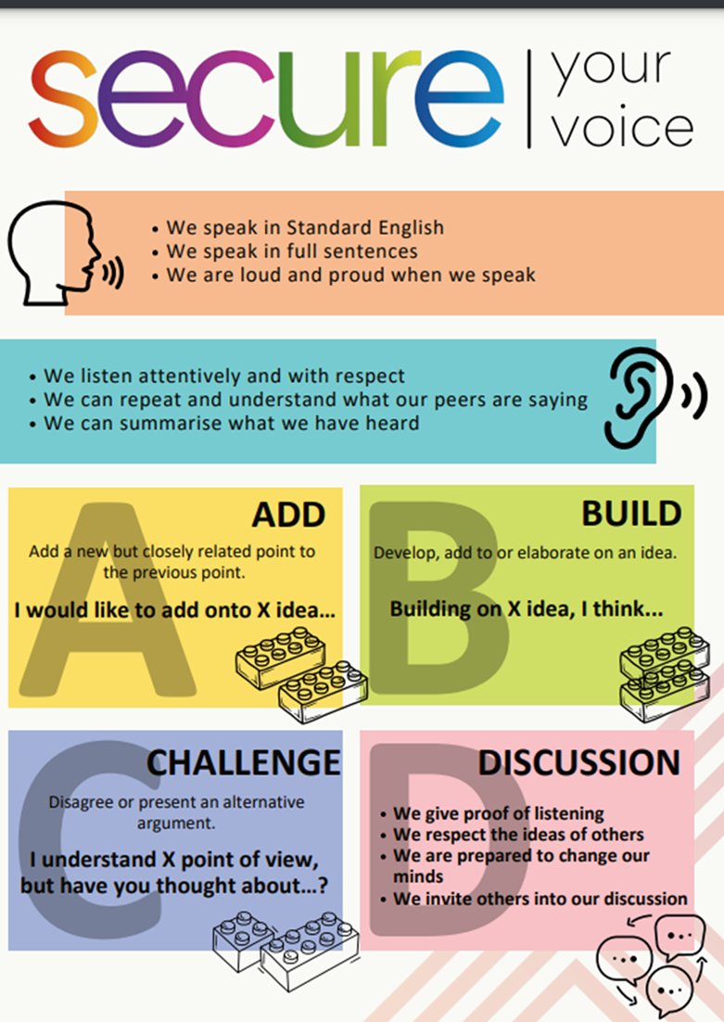
Discussion
With the person next to you discuss the following:
“What does STI stand for?
Remember to use your oracy helpsheet to structure your discussion.
Be ready to share your discussions with the class.

Slide 6
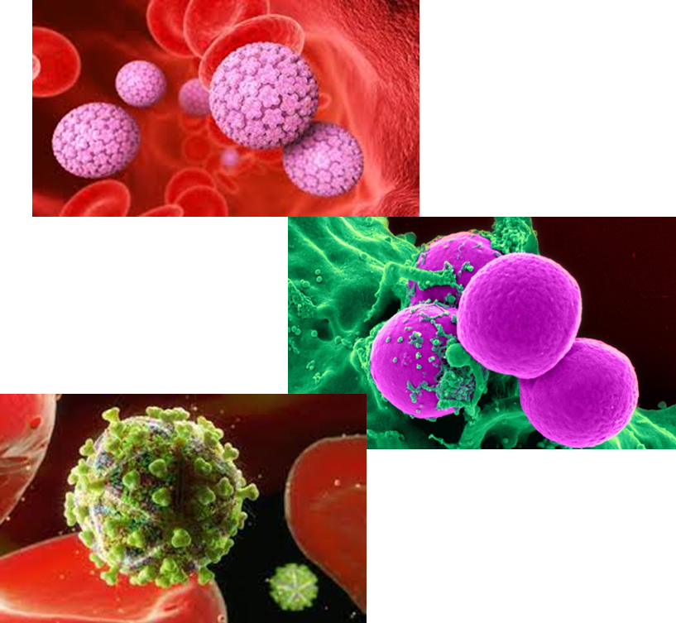
What does STI stand for?
STI stands for:
“sexually transmitted infection”

Slide 7
What is the difference between STI and STD?
STI stands for:
“sexually transmitted infection”
And STD stands for:
“sexually transmitted disease”
They relate to the same thing. However STD may be used when symptoms of an infection (STI) appear

Slide 8
Discussion
With the person next to you discuss the following:
“What STI’s have you heard about?
Remember to use your oracy helpsheet to structure your discussion.
Be ready to share your discussions with the class.

Slide 9
Common STI’s
Common STI’s that most people may have about are:
Herpes
Syphilis
Gonorrhea
Chlamydia
HIV
HPV

Slide 10
Why are you learning about this?
We will cover STI’s and how they are transmitted more in your Personal Development lessons this week.
But key points you need to know about this topic for your future wellbeing are:
If a STI is left untreated, it can cause fertility complications and long term health conditions
The age group in the UK with the highest STI diagnosis rates is 15-24 year olds.

Slide 11
Fact or myth
Discuss if the statement below is a fact or myth about STI’s:
“Only older people get STI’s”
This is a myth. Anyone who is sexually active, regardless of age can get a STI.

Slide 12
Fact or myth
Discuss if the statement below is a fact or myth about STI’s:
“If a person gets an STI once, they can’t get it again”
This is a myth. People can get the same STI more than once if exposed again, especially for bacterial infections like chlamydia or gonorrhea.

Slide 13
Fact or myth
Discuss if the statement below is a fact or myth about STI’s:
“People can get a STI even if it is their first time having sex”
This is a fact. STIs can be transmitted any time there’s sexual contact, even the first time.

Slide 14
Fact or myth
Discuss if the statement below is a fact or myth about STI’s:
“STI’s require medical treatment”
This is a fact. STIs require medical treatment to be cured or managed. STI’s will not go away on their own.

Slide 15
Fact or myth
Discuss if the statement below is a fact or myth about STI’s:
“It is clear if a person has a STI just by looking at them”
This is a myth. Many STIs have no visible symptoms, so someone can have an STI and not know it.

Slide 16
Support
If you need any support about STI’s, you can contact
Umbrellahealth.co.uk
List of services near you
Email and contact numbers available online

