Slide 1
Remember to complete all homework tasks on SAM Learning
We still use Classcharts for announcements, surveys and revision material
Homework Club every morning in West Canteen from 8am
Library is open before school and at break times
Make sure you are completing the SET TASKS! These are the tasks your teachers have set.
Notes:
Please give time for the students to produce answers for themselves before showing answers.

Slide 3
Thought of the Day
“Alcohol and drugs rob the mind of clarity, replacing hope with fear and confusion”

Slide 4
Secure your Wellbeing: Learning Journey
What is mental health?
Impact of drugs and alcohol on mental health
What is gambling?
What are eating disorders?
How to deal with emotions?
How to deal with fallouts
Today we will look at:
Drugs, alcohol and mental health
This includes:
Definition of alcohol
Definition of drugs
Myths around drugs and alcohol
Please remember that during the lesson we should not be asking any pupil or teacher personal questions.
Your teacher can ask you questions but this will be to check your knowledge in the lesson.

Slide 5
Why are we learning about this?
Learning about the negative impacts of drugs and alcohol will help secure your wellbeing.
Although using drugs and alcohol is against some religions, it is still important to learn about the negative impacts so you can teach others about the consequences of using drugs and alcohol

Slide 6
Why are we learning about this?
Rule of Law is a British Value. In the UK it is illegal for U18’s to purchase alcohol. It is also illegal for anyone in the UK to use drugs classed as A, B or C. These mean that they are illegal drugs in the UK

Slide 7
Why are we learning about this?
Article 33 states that children and young people have the right to be protected from harmful drugs. To be protected, children should be taught about the negative effects of drugs (including alcohol) on the body and mind.
UN Rights
of a Child

Slide 8
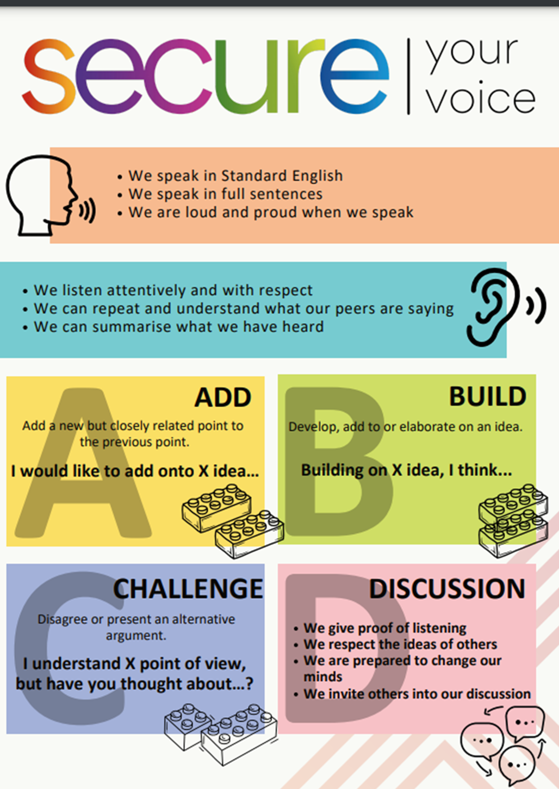
What is alcohol?
Take out your oracy helpsheet from your learning wallet.
You have 1 minute to think about the following question:
“What is alcohol?”

Slide 9
What is alcohol?
Using your oracy helpsheet, with the person next to you, discuss your response to the question:
“What is alcohol?”
Remember to use the sentence starters to add, build or challenge what your partner has said.
Be ready to share your discussion with the class

Slide 10
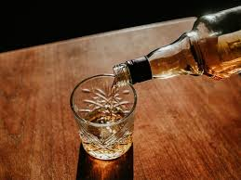
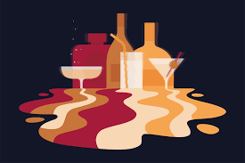
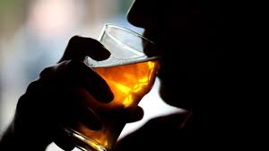
What is alcohol?
Alcohol is…
“a clear liquid commonly found in drinks such as beer, wine and spirits”
Alcohol is classed as a drug.

Slide 11
What are drugs?
Take out your oracy helpsheet from your learning wallet.
You have 1 minute to think about the following question:
“What are drugs?”

Slide 12
What are drugs?
Using your oracy helpsheet, with the person next to you, discuss your response to the question:
“What are drugs?”
Remember to use the sentence starters to add, build or challenge what your partner has said.
Be ready to share your discussion with the class

Slide 13
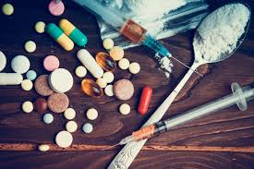
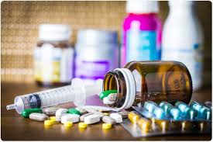
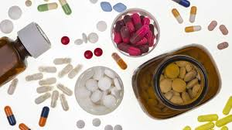
What are drugs?
Drugs are…
“chemicals or substances that change the way our body work”
Not all drugs are illegal. Drugs such as paracetamol are legal and can be purchased easily. However there are lots of illegal drugs such as heroin, cocaine and marijuana

Slide 14
Myth or Fact
We are now going to look at different statements about drugs and alcohol.
You will have to decide if you think the statement is a myth or a fact.

Slide 15
Myth or Fact
Decide if the following statement is a myth or fact.
“Alcohol is not harmful in small amounts for young people”
This is a myth. Even small amounts of alcohol can affect a teen’s developing brain and may increase the risk of alcohol-related issues later on.

Slide 16
Myth or Fact
Decide if the following statement is a myth or fact.
“Despite marijuana being natural, it is not safe to use
This is a fact. Although marijuana is a plant, it still affects the brain and body, especially for teens, and can lead to memory issues, learning problems, and dependency.

Slide 17
Myth or Fact
Decide if the following statement is a myth or fact.
“Despite marijuana being natural, it is not safe to use
This is a fact. Although marijuana is a plant, it still affects the brain and body, especially for teens, and can lead to memory issues, learning problems, and dependency.

Slide 18
Myth or Fact
Decide if the following statement is a myth or fact.
“Using drugs and alcohol can change how you feel but the effects don’t last long”
This is a myth. Drugs and alcohol can have long-term effects on mood, mental health, and physical health, especially if used frequently.

Slide 19
Myth or Fact
Decide if the following statement is a myth or fact.
“teen brains are more vulnerable to drugs and alcohol than adult brains”
This is a fact. Teen brains are still developing, especially the areas controlling decision-making and impulse control, making them more sensitive to the effects.

Slide 20
Myth or Fact
Decide if the following statement is a myth or fact.
“caffeine is also a drug because it affects how your brain works”
This is a fact. Caffeine is a stimulant and can be considered a drug because it temporarily boosts alertness but can lead to dependency. However it is not illegal despite being a drug

Slide 21
Myth or Fact
Decide if the following statement is a myth or fact.
“You can’t get addicted to drugs if you only use them occasionally.”
This is a myth. Even occasional use can lead to cravings and dependency, particularly for certain drugs.

Slide 22
Support
If you ever need support about alcohol and drugs for yourself, a friend or family member you can find it here:
Childline.org.uk
Call – 08001111
Email or chat online for support
Themix.org.uk
You can email or have one-to-chat online.
There is also a crisis messenger which is available 24/7

