Slide 1
Write the date: 14 April 2025
Write the Title and Golden Thread
Title – Protected Characteristics
Golden Thread – Secure Your Relationships
Underline both using your ruler & take out your oracy helpsheet
Complete the following questions:
What is being described: “the variety of differences among people”
True or False – “equality and equity are the same thing”
What impact can a negative online presence have?
Diversity
False
It can affect future places at university and job applications

Slide 3
Secure your Relationships: Learning Journey
What is the difference between equality and equity
Celebrating culture and diversity in Birmingham
What are Protected Characteristics?
What is a hate crime?
What laws impact society?
Current issues in the UK
Today we will look at:
What are the protected characteristics
This includes:
What are the 9 Protected Characteristics
What law states the protected characteristics
Examples of why protected characteristics are needed
Please remember that during the lesson we should not be asking any pupil or teacher personal questions.
Your teacher can ask you questions but this will be to check your knowledge in the lesson.

Slide 4
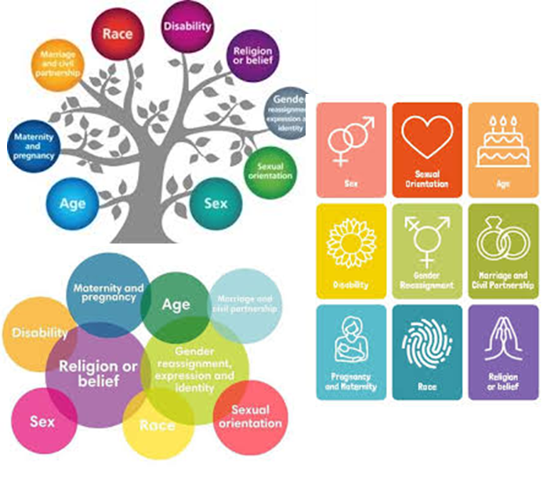
Tutor Time Recap
In your Personal Development Tutor Time activity, you started to look at protected characteristics.
In your books answer the following question:
“What are protected characteristics?”
Sentence starter – “Protected characteristics are…”

Slide 5
Tutor Time Recap
Protected characteristics are…
“specific characteristics that are safeguarded against discrimination under the Equality Act 2010”
Task – use your red pen to add to the definitions you had written down.

Slide 6
Tutor Time Recap
You also looked at the 9 protected characteristics.
Make a list of the 9 protected characteristics.

Slide 7
Tutor Time Recap
The 9 Protected Characteristics are:
Age
Disability
Gender reassignment
Marriage and civil partnership
Pregnancy and maternity
Race
Religion or belief
Sex
Sexual orientation
Task – use your red pen to add to your list

Slide 8
Tutor Time Recap
This links to the Golden Thread of “Secure your Relationships” as stronger relationships are formed if people understand and appreciate that everyone is different
Rule of Law is a British Value that means people are expected to follow the laws to keep everyone safe. Protected characteristics are outlined in the Equality Act (2010).
Article 2 states that no child should be treated unfairly for any reason. This includes those who identify with 1 or more protected characteristics
The Equality Act (2010) sets out 9 Protected Characteristics which means people who identify with these characteristics should not be treated any differently and these differences should be celebrated
UN Rights
of a Child

Slide 9
Why are the protected characteristics needed?
The Equality Act (2010) which outlines the 9 protected characteristics is designed to stop discrimination.
Discrimination can either be:
Direct
Indirect

Slide 10
Why are the protected characteristics needed?
Direct Discrimination is…
“someone is treated worse than others because of a characteristic”
Indirect Discrimination is…
“a rule or policy that applies to everyone but unfairly disadvantages certain people”

Slide 11
Hinge Questions – whiteboard activity
3
Rules!
I will ask the question and give you some thinking time. (no more than 10 seconds)
Write the answer and turn your whiteboard over so nobody can see it.
When I am ready I will put on the 3 to 1 counter.
When ‘Show me’ appears on the board you must hold up your whiteboard (even if you don’t know the answer and there is nothing on your board)
2
1
Show me!
(even if your whiteboard is blank)

Slide 12
Hinge Questions – whiteboard activity
What is being described?
“specific characteristics that are safeguarded against discrimination under the Equality Act 2010”
Protected Characteristics

Slide 13
Hinge Questions – whiteboard activity
What Golden Thread does today’s lesson relate to?
A – Secure your Voice
B – Secure your Relationships
C – Secure your Wellbeing
D – Secure your Future

Slide 14
Hinge Questions – whiteboard activity
True or False
“The Equality Act (2010) outlines 9 protected characteristics”
A – True
B – False

Slide 15
Hinge Questions – whiteboard activity
What type of discrimination is being described?
“someone is treated worse than others because of a characteristic”
A – Direct
B – Indirect

Slide 16
Hinge Questions – whiteboard activity
What type of discrimination is being described?
“a rule or policy that applies to everyone but unfairly disadvantages certain people”
A – Direct
B – Indirect

Slide 17
Why are the protected characteristics needed?
Despite the Equality Act being in place since 2010, discrimination against protected characteristics still exists. Examples of this include:
Women are still paid less than men and less likely to hold management positions
Those from the LGBT community are more likely to bullied in school
Ethnic minorities face racism within communities in the UK

Slide 18
Why are the protected characteristics needed?
In pairs work together to sort out the cards into:
The Protected Characteristics
The definition of each characteristic
An example of the protected characteristic

Slide 19
Why are the protected characteristics needed?
While going through the correct answers, make sure you have sorted the cards into the right order as you will be using these to help make notes

Slide 20
Why are the protected characteristics needed?
Age
People belonging to a particular age group
An employer telling a person they are too old for the job despite them not being at retirement age

Slide 21
Why are the protected characteristics needed?
Gender Reassignment
People who propose to, are undergoing, or have completed a process to reassign their sex
Graffiti on toilet walls making threats against trans people

Slide 22
Why are the protected characteristics needed?
Marriage and Civil Partnership
People who have entered into a civil partnership or marriage, including same sex and mix sex couples
A person struggling to get a promotion. They have been told it is because they are married so may not work as hard

Slide 23
Why are the protected characteristics needed?
Pregnancy and Maternity
People who are pregnant or who have had a baby in the past 26 weeks. People who work are also entitled to maternity leave if they have a baby
Local cafes and restaurants having a safe space for women to breast feed babies

Slide 24
Why are the protected characteristics needed?
Disability
People with long term physical or mental conditions that have a substantial negative effect on the day to day activities
Being born with a condition that means they require a wheelchair to move around

Slide 25
Why are the protected characteristics needed?
Race
Includes a person’s skin colour, nationality or ethnic background
Graffiti in a local playground saying only people of a certain skin colour can use it

Slide 26
Why are the protected characteristics needed?
Religion or Belief
Any religion and religious or philosophical belief, or not having these
Schools having a multi faith prayer room for pupils of all religions to use during break times

Slide 27
Why are the protected characteristics needed?
Sex
Being a man or a woman
Overhearing a conversation between 2 males who were talking about jobs women should and should not do

Slide 28
Why are the protected characteristics needed?
Sexual Orientation
Whether a person is attracted to people of the same sex as them or of a different sex, or both.
Schools including pictures of same sex and mixed sex couple in their lessons about healthy relationships

Slide 29
Why are the protected characteristics needed?
In the margin write “SYV” – this stands for “Secure Your Voice”
Highlight “SYV”
Write down 3 protected characteristics, their definition and an example of this protected characteristic. You should choose 3 that you feel are most applicable to you

Slide 30
Challenging discrimination
Although it may seem difficult, it is important to challenge discrimination whenever you see or hear it happening.
This includes if the person who is discriminating someone else is a friend or family member

Slide 31
Challenging discrimination
Ways to challenge discrimination are:
Speaking up when witnessing discrimination
Show support to the person who is being discriminated against, even if you do not know them
Educate family and friends about discrimination and why it is important to be respectful
Encourage inclusion in school and social spaces

Slide 32
Challenging discrimination
Ways to challenge discrimination are:
Speaking up when witnessing discrimination
Show support to the person who is being discriminated against, even if you do not know them
Educate family and friends about discrimination and why it is important to be respectful
Encourage inclusion in school and social spaces
In the margin write “SYV” – this stands for “Secure Your Voice”
Highlight “SYV”
Complete the following sentence
“Ways to challenge discrimination are…”
Write down the 4 ways to challenge discrimination in order of what you think would be most effective

Slide 33
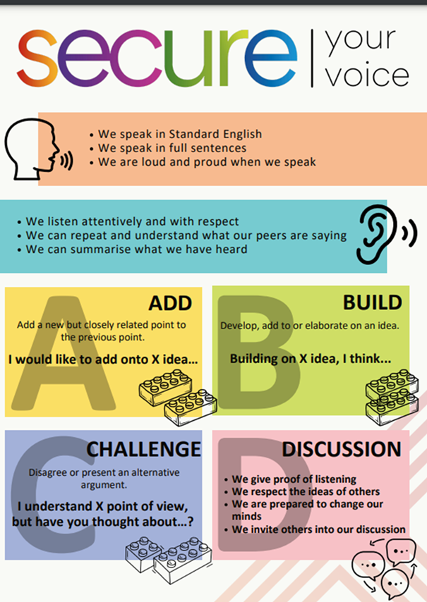
Challenging discrimination
Using your oracy helpsheet, discuss with the person next to you the question:
“What do you think is the most effective way to challenge discrimination?”
Remember to use the sentence starters to add, build or challenge what your partner has said.
Be ready to share your discussion with the class

Slide 34
Challenging discrimination
Zara is 14 years old and is in a wheelchair. In school, they have been asked to get into groups to complete a project that will require moving around the school building. Zara asks if she can join a group that her best friend Emma is in. Another girl in the group says no to Zara joining as she will slow them down as she is in a wheelchair. Zara is upset and her best friend Emma remained silent throughout the exchange despite being able to hear everything
In the margin write “SYV” – this stands for “Secure Your Voice”
Highlight “SYV”
Write down how you think Zara’s best friend Emma should have reacted. Explain why.

Slide 35
Challenging discrimination
Using your oracy helpsheet, discuss with the person next to you the question:
“How do you think Emma should have reacted?”
Remember to use the sentence starters to add, build or challenge what your partner has said.
Be ready to share your discussion with the class

Slide 36
Support
If you ever need support about discrimination/protected characteristics for yourself, a friend or family member it can be found here:
Childline.org.uk
Call – 08001111
Email or chat online for support
Themix.org.uk
You can email or have one-to-chat online.
There is also a crisis messenger which is available 24/7

