Slide 1
Write the date: 14 April 2025
Write the Title and Golden Thread
Title – What is a hate crime
Golden Thread – Secure Your Relationships
Underline both using your ruler & take out your oracy helpsheet
Complete the following questions:
What is being described: “specific characteristics that are safeguarded against discrimination under the Equality Act 2010”
What is being described: “a way of life for a group of people”
Explain the difference between equality and equity
Protected characteristics
Culture
Equality is treating everyone the same regardless of their needs, equity is allowing everyone to get the same access to something regardless of their needs

Slide 3
Secure your Relationships: Learning Journey
What is the difference between equality and equity
Celebrating culture and diversity in Birmingham
What are Protected Characteristics?
What is a hate crime?
What laws impact society?
Current issues in the UK
Today we will look at:
What is a hate crime
This includes:
What is classed as a hate crime
Why people do not report hate crime
Why hate crimes should be reported
Please remember that during the lesson we should not be asking any pupil or teacher personal questions.
Your teacher can ask you questions but this will be to check your knowledge in the lesson.

Slide 4
Tutor Time Recap
In your Personal Development Tutor Time activity, you started to look at hate crime.
In your books answer the following question:
“What is a hate crime?” This should include the 5 categories of hate crime
Sentence starter – “A hate crime is…”

Slide 5
Tutor Time Recap
Hate crime is…
“a criminal act motivated by prejudice, hostility or hatred towards a person’s race, religion, sexual orientation or gender identity”
Task – use your red pen to add to the definitions you had written down.

Slide 6
Tutor Time Recap
This links to the Golden Thread of “Secure your Relationships” as celebrating, and not hating, differences builds better and stronger relationships between people
Rule of Law is a British Value that means people are expected to follow the laws to keep everyone safe. Hate crimes are against the law – Criminal Justice Act 2003
Article 2 states that no child should be treated unfairly for any reason.
The Equality Act (2010) sets out 9 Protected Characteristics which means people who identify with these characteristics should not be treated any differently. Unfortunately many hate crimes happen to people who identify with 1 or more of the protected characteristics.
UN Rights
of a Child

Slide 7
What is classed as a hate crime?
Hate crimes include:
Physical attacks
Threats – offline and online
Vandalism
Verbal abuse
Online Harassment
Hate crimes can be committed by adults and young people. Young people can still face severe punishments for committing a hate crime

Slide 8
What is classed as a hate crime?
Hate crimes include:
Physical attacks
Threats – offline and online
Vandalism
Verbal abuse
Online Harassment
In the margin write “SYV” – this stands for “Secure Your Voice”
Highlight “SYV”
Write down the 5 types of hate crime. These should be in order of what you think is most common.

Slide 9
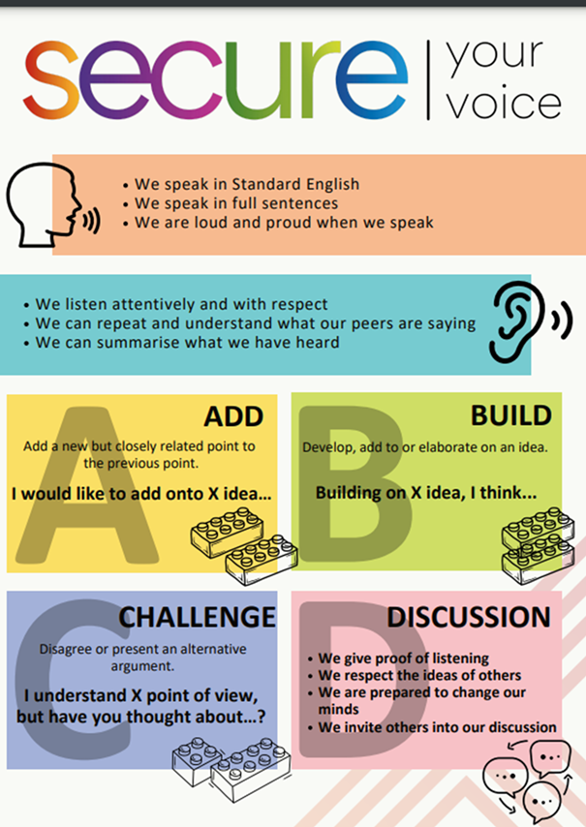
What is classed as a hate crime?
Using your oracy helpsheet, discuss with the person next to you the question:
“What type of hate crime do you think is most common? Why?”
Remember to use the sentence starters to add, build or challenge what your partner has said.
Be ready to share your discussion with the class

Slide 10
Hinge Questions – whiteboard activity
3
Rules!
I will ask the question and give you some thinking time. (no more than 10 seconds)
Write the answer and turn your whiteboard over so nobody can see it.
When I am ready I will put on the 3 to 1 counter.
When ‘Show me’ appears on the board you must hold up your whiteboard (even if you don’t know the answer and there is nothing on your board)
2
1
Show me!
(even if your whiteboard is blank)

Slide 11
Hinge Questions – whiteboard activity
What is being described?
“a criminal act motivated by prejudice, hostility or hatred towards a person’s race, religion, sexual orientation or gender identity”
Hate crime

Slide 12
Hinge Questions – whiteboard activity
What Golden Thread does today’s lesson relate to?
A – Secure your Voice
B – Secure your Relationships
C – Secure your Wellbeing
D – Secure your Future

Slide 13
Hinge Questions – whiteboard activity
What type of hate crime is being described?
“someone being pushed and punched due to their race”
A – Physical Attack
B – Threats
C – Vandalism
D – Verbal abuse

Slide 14
Hinge Questions – whiteboard activity
What type of hate crime is being described?
“someone who identifies as LGBT+ being sent an anonymous message on social media telling them to stay away from school the next day or else.”
A – Physical Attack
B – Threats
C – Vandalism
D – Verbal abuse

Slide 15
Hinge Questions – whiteboard activity
What type of hate crime is being described?
“personal insults being shouted at a person due to their disability.”
A – Online Harassment
B – Vandalism
C – Verbal Abuse
D – Physical attack

Slide 16
Hinge Questions – whiteboard activity
What type of hate crime is being described?
“windows of a religious building being smashed.”
A – Online Harassment
B – Vandalism
C – Verbal Abuse
D – Physical attack

Slide 17
Hinge Questions – whiteboard activity
What type of hate crime is being described?
“a fake account being made mocking a person’s ethnic background. The person the account mocks, has been tagged in all the posts so they see the comments too”
A – Online Harassment
B – Vandalism
C – Verbal Abuse
D – Physical attack

Slide 18
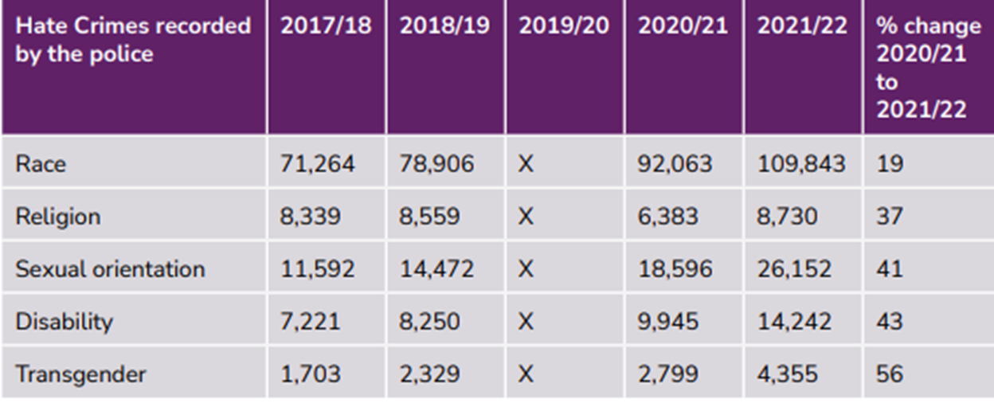
Hate Crime
In tutor time you looked at the table below which shows the number of reported hate crimes by category.
Despite these already high numbers of hate crimes, it is widely accepted that a lot of victims of hate crimes do not report this to Police.
This means that these figures are actually much higher.

Slide 19
Hate Crime
In the margin write “SYV” – this stands for “Secure Your Voice”
Highlight “SYV”
Complete the following sentence…
“I think people do not report hate crimes because…”

Slide 20
Hate crimes
Using your oracy helpsheet, discuss with the person next to you the question:
“Why do you think people do not report hate crimes?”
Remember to use the sentence starters to add, build or challenge what your partner has said.
Be ready to share your discussion with the class

Slide 21
Hate Crime
Some reasons why people do not always report hate crimes are:
Lack of confidence of anything being done
Fear of retaliation if found out that they reported someone
Fear of being judged
Not understanding they have been a victim of hate crime due to language barriers
Some things classed as hate crime have become normalised
Task – Use your red pen to add to your previous sentence.

Slide 22
Hate Crime
It is important that hate crimes are reported in order for action to be take in order to stop hate crime happening at all.
This is important because hate crime has a huge negative impact on victims.

Slide 23
Hate Crime
Why should be reported
Perpetrators can be bought to justice and be prevented from hurting someone else
Vulnerable people in communities can be protected
Authorities who the hate crime is reported to can help victims access support services which will help them to feel safe once more following a hate crime
Some hate crimes begin as small incidents before they escalate into more serious and frequent attacks – every report matters and can save lives.
In the margin write “SYV” – this stands for “Secure Your Voice”
Highlight “SYV”
Complete the following sentences…
1. “I think the most important reason hate crimes should be report is…”
2. “I think this because…”

Slide 24
Hate crimes
Using your oracy helpsheet, discuss with the person next to you the question:
“What do you think is the most important reason for hate crimes to be reported?”
Remember to use the sentence starters to add, build or challenge what your partner has said.
Be ready to share your discussion with the class

Slide 25
Hinge Questions – whiteboard activity
3
Rules!
I will ask the question and give you some thinking time. (no more than 10 seconds)
Write the answer and turn your whiteboard over so nobody can see it.
When I am ready I will put on the 3 to 1 counter.
When ‘Show me’ appears on the board you must hold up your whiteboard (even if you don’t know the answer and there is nothing on your board)
2
1
Show me!
(even if your whiteboard is blank)

Slide 26
Hinge Questions – whiteboard activity
True or False
“the numbers of reported hate crimes are accurate”
A – True
B – False

Slide 27
Hinge Questions – whiteboard activity
True or False
“victims of hate crime do not report hate crimes as they don’t think anything will be done about it”
A – True
B – False

Slide 28
Hinge Questions – whiteboard activity
True or False
“victims of hate crime do not report hate crimes as they don’t think what they have experienced is a hate crime”
A – True
B – False

Slide 29
Hinge Questions – whiteboard activity
True or False
“hate crimes should be reported in order to support victims with what they have experienced”
A – True
B – False

Slide 30
Hinge Questions – whiteboard activity
True or False
“hate crimes should be reported in order to stop small incidents of hate crime escalating into more serious incidents”
A – True
B – False

Slide 31
Hate Crime - scenario
Amir, a 14-year-old British Pakistani boy, plays for his school’s football team. During a match against another school, a group of students in the crowd start chanting racial slurs at him every time he gets the ball.
In the margin write “SYV” – this stands for “Secure Your Voice”
Highlight “SYV”
Complete the following questions
What hate crime has Amir experienced?
What advice would you give Amir about what to do next?

Slide 32
Hate crimes
Using your oracy helpsheet, discuss with the person next to you the question:
“What hate crime has Amir experienced? What advice would you give Amir about what to do next?”
Remember to use the sentence starters to add, build or challenge what your partner has said.
Be ready to share your discussion with the class

Slide 33
Hate Crime - scenario
Hana, a 13-year-old Muslim girl, wears a hijab as part of her faith. One day after school, she gets on the bus with her friends. A group of older teenagers sitting at the back of the bus start whispering and laughing while looking at her. One of them pulls at her hijab before running off the bus. Hana is left feeling scared and embarrassed.
In the margin write “SYV” – this stands for “Secure Your Voice”
Highlight “SYV”
Complete the following questions
What hate crime has Hana experienced?
What advice would you give Hana about what to do next?

Slide 34
Hate crimes
Using your oracy helpsheet, discuss with the person next to you the question:
“What hate crime has Hana experienced? What advice would you give Hana about what to do next?”
Remember to use the sentence starters to add, build or challenge what your partner has said.
Be ready to share your discussion with the class

Slide 35
Hate Crime - scenario
Leo, a 14-year-old student, recently told his close friends that he is gay. One day in class, his friend group gets into an argument. One of the boys, who is angry, shouts across the room, "Shut up, no one cares what you think. You’re just a freak anyway!" Other students in the class start laughing, and someone whispers, "He’s probably got a crush on you!"
In the margin write “SYV” – this stands for “Secure Your Voice”
Highlight “SYV”
Complete the following questions
What hate crime has Leo experienced?
What advice would you give Leo about what to do next?

Slide 36
Hate crimes
Using your oracy helpsheet, discuss with the person next to you the question:
“What hate crime has Leo experienced? What advice would you give Leo about what to do next?”
Remember to use the sentence starters to add, build or challenge what your partner has said.
Be ready to share your discussion with the class

Slide 37
Support
If you ever need support about hate crimes for yourself, a friend or family member you can find it here:
Childline.org.uk
Call – 08001111
Email or chat online for support
Call 999 if you or a friend is a victim of a hate crime

