Slide 2
Write the date: 14 April 2025
Write the Title and Golden Thread
Title – What are the dangers of knife crime?
Golden Thread – Secure Your Wellbeing
Underline both using your ruler & take out your oracy helpsheet
Complete the following questions:
What is being described: “A group of people who come together with a shared identity, often involving illegal activities or antisocial behaviour.”
Give an example of criminal activity
How do you set goals?
Gangs
Graffiti, Antisocial behaviour, shoplifting,
Use SMART

Slide 3
Secure your Wellbeing: Learning Journey
Importance of role models
Why is failure a good thing
What is criminal activity?
Dangers of gang culture
Dangers of knife crime
What does your online presence look like?
Today we will look at:
What are the dangers of knife crime
This includes:
Why people carry knives
Risk and consequences of knife crime
Ripple effect of knife crime
Please remember that during the lesson we should not be asking any pupil or teacher personal questions.
Your teacher can ask you questions but this will be to check your knowledge in the lesson.

Slide 4
Tutor Time Recap
In your Personal Development Tutor Time activity, you started to look at knife crime.
In your books answer the following question:
“What is the definition of knife crime?”
Sentence starter – “knife crime is…”

Slide 5
Tutor Time Recap
Knife crime is:
“Criminal offences committed using a knife as a weapon”
Task – use your red pen to add to the definition you had written down.

Slide 6
Tutor Time Recap
This links to the Golden Thread of “Secure your Wellbeing” as knives are dangerous and can lead to people being seriously injured or dead.
Rule of Law is a British Value that means everyone in the UK is expected to adhere to the law. Carrying a knife or using a knife as a weapon is illegal
Article 29 of the UN Rights of Child states that children’s education should help them live peacefully. Learning about the dangers of knife crime is important in order for knife crime levels decreasing.
UN Rights
of a Child

Slide 7
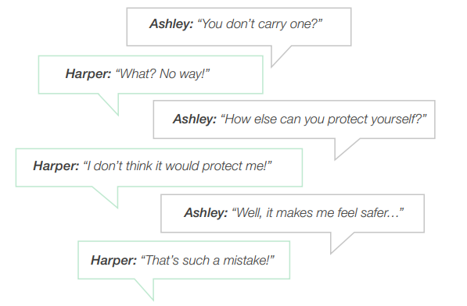
Why people carry knives?
In Tutor Time this week you looked at this conversation.
It highlighted one reason why people carry knives.
This reason is “for safety”

Slide 8
Why people carry knives?
Other reasons why people carry knives include:
For status/reputation
To feel powerful
To be accepted by a group/gang
They think everyone is carrying one
They know some family do it

Slide 9
Why people carry knives?
Complete the instructions below:
In the margin write “SYV” – this stands for “Secure Your Voice”
Highlight “SYV”
Write out the reasons in order of what you think is the most common reason.
For status/reputation
To feel powerful
To be accepted by a group/gang
They think everyone is carrying one
They know some family do it
For safety

Slide 10
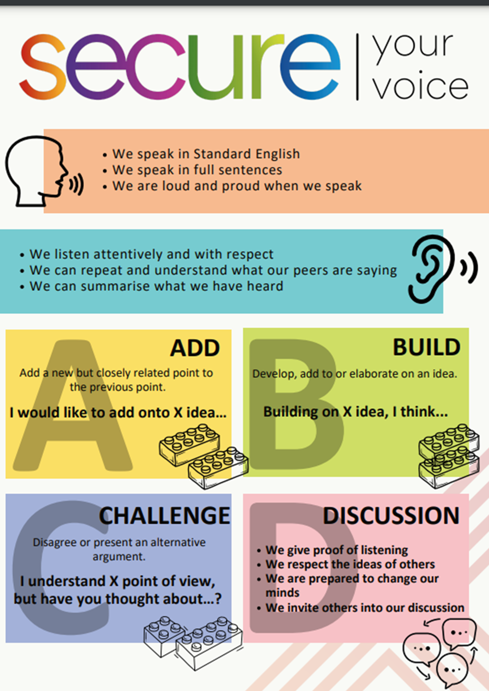
Why people carry knives?
Using your oracy helpsheet, discuss with the person next to you the question:
“what did you think the most common reason was for a person carrying a knife?”
Remember to use the sentence starters to add, build or challenge what your partner has said.
Be ready to share your discussion with the class

Slide 11
Why people carry knives?
It is important to remember that 99% of young people do not carry a knife.
Despite one reason being for “safety” – those who carry a knife are more likely to be hospitalised with a violence related injury and in many cases their own weapon has been used against them.

Slide 12
Hinge Questions – whiteboard activity
3
Rules!
I will ask the question and give you some thinking time. (no more than 10 seconds)
Write the answer and turn your whiteboard over so nobody can see it.
When I am ready I will put on the 3 to 1 counter.
When ‘Show me’ appears on the board you must hold up your whiteboard (even if you don’t know the answer and there is nothing on your board)
2
1
Show me!
(even if your whiteboard is blank)

Slide 13
Hinge Questions – whiteboard activity
What is being described?
“criminal offences committed using a knife as a weapon”
Knife Crime

Slide 14
Hinge Questions – whiteboard activity
What Golden Thread does today’s lesson relate to?
A – Secure your Voice
B – Secure your Relationships
C – Secure your Wellbeing
D – Secure your Future

Slide 15
Hinge Questions – whiteboard activity
True or False
“most young people carry a knife”
A – True
B – False

Slide 16
Hinge Questions – whiteboard activity
True or False
“people who carry a knife are more likely to end up in hospital”
A – True
B – False

Slide 17
Hinge Questions – whiteboard activity
True or False
“many people who carry a knife are actually hurt by their own knife”
A – True
B – False

Slide 18
Risks and Consequences
There are many risks and consequences of knife crime. They can be split into 4 categories:
Physical consequences
Emotional consequences
Social consequences
Legal consequences

Slide 19
Risks and Consequences
Decide what category each statement matches too.
Physical consequences
A person can get 4 years in jail for carrying a knife
People who carry a knife may feel fearful and stressed
Emotional consequences
A person can die from knife crime
If convicted due to knife crime it is harder to get a job or travel to some countries
Social consequences
A person’s family would constantly worry about them
Friends will stop hanging out because they are scared of the knife
A person can get a life sentence of 25 if a knife has been used in an attack
Legal consequences
A person could end up in hospital if attacked with a knife

Slide 20
Hinge Questions – whiteboard activity
3
Rules!
I will ask the question and give you some thinking time. (no more than 10 seconds)
Write the answer and turn your whiteboard over so nobody can see it.
When I am ready I will put on the 3 to 1 counter.
When ‘Show me’ appears on the board you must hold up your whiteboard (even if you don’t know the answer and there is nothing on your board)
2
1
Show me!
(even if your whiteboard is blank)

Slide 21
Hinge Questions – whiteboard activity
What risk and consequence does the statement match too?
“A person can get 4 years in jail for carrying a knife”
A – Physical consequence
B – Emotional consequence
C – Social consequence
D – Legal consequence

Slide 22
Hinge Questions – whiteboard activity
What risk and consequence does the statement match too?
“A person can die from a knife attack”
A – Emotional consequence
B – Legal consequence
C – Physical consequence
D – Social consequence

Slide 23
Hinge Questions – whiteboard activity
What risk and consequence does the statement match too?
“A person’s family will constantly worry about them”
A – Social consequence
B – Emotional consequence
C – Physical consequence
D – Legal consequence

Slide 24
Hinge Questions – whiteboard activity
What risk and consequence does the statement match too?
“Friends will stop hanging out as they are scared of the knife”
A – Social consequence
B – Emotional consequence
C – Physical consequence
D – Legal consequence

Slide 25
Risks and Consequences
Create a table that shows the different risks and consequences of knife crime
4 have been given to you on the right. Add in others that we have spoken about
Risks and Consequences
A person can get 4 years in jail for carrying a knife
A person can die from a knife attack
A person’s family will constantly worry about them
Friends will stop hanging out as they are scared of the knife
Physical consequences | Emotional consequences | Social consequences | Legal conseqences

Slide 26
Ripple Effect
Ripple effect means:
“the continuing and spreading results of an event of action.”
This means that the effect of knife crime does not stop when an attack happens. There are many more effects

Slide 27
Ripple Effect
While watching the video think about what are some of the results of a person saying yes to carrying a knife

Slide 28
Ripple Effect
Complete the instructions below:
In the margin write “SYV” – this stands for “Secure Your Voice”
Highlight “SYV”
Complete the following sentence – “a ripple effect of saying yes to carrying a knife is…”

Slide 29
Ripple effect
Using your oracy helpsheet, discuss with the person next to you the question:
“what did you say was a ripple effect of saying yes to carrying a knife?”
Remember to use the sentence starters to add, build or challenge what your partner has said.
Be ready to share your discussion with the class

Slide 30
Reflection
Knife crime is not a joke.
Knife crime can and does lead to people dying.
Although people may think differently, official statistics show that 99% of young people do not carry a knife.
Say “no” to carrying a knife.

Slide 31
Support
If you ever need support about knife crime for yourself, a friend or family member you can find it here:
Childline.org.uk
Call – 08001111
Email or chat online for support
If an emergency call 999 and ask to speak to the police
If it is not an emergency call 101 and ask to speak to the police

