Slide 1
Write the date: 14 April 2025
Write the Title and Golden Thread
Title – Equality vs Equity
Golden Thread – Secure Your Relationships
Underline both using your ruler & take out your oracy helpsheet
Complete the following questions:
What is being described: “everything someone posts, likes, shares and interacts with online”
True or False – Most young people carry knives
Gangs try to recruit people by showing them a glamourous lifestyle and giving free things. Are they are always free?
Online Presence
False
No – this will be a debt

Slide 3
Secure your Relationships: Learning Journey
What is the difference between equality and equity
What is culture and diversity?
What does inclusion mean?
Exploring the 9 Protected Characteristics
What is a hate crime?
What laws impact society?
Today we will look at:
The difference between equality and equity
This includes:
Definition of equality and equity
Examples
Please remember that during the lesson we should not be asking any pupil or teacher personal questions.
Your teacher can ask you questions but this will be to check your knowledge in the lesson.

Slide 4
Tutor Time Recap
In your Personal Development Tutor Time activity, you started to look at the importance of equality & equity
In your books answer the following question:
“What is the definition of equality?”
Sentence starter – equality is…”

Slide 5
Tutor Time Recap
Equality is:
“treating everyone the same regardless of their individual needs or circumstances”
Task – use your red pen to add to the definition you had written down.

Slide 6
Tutor Time Recap
In your Personal Development Tutor Time activity, you started to look at the importance of online presence
In your books answer the following question:
“What is the definition of equity?”
Sentence starter – equity is…”

Slide 7
Tutor Time Recap
Equity is:
“giving people the resources they need based on their individual circumstances to achieve the same outcome”
Task – use your red pen to add to the definition you had written down.

Slide 8
Tutor Time Recap
This links to the Golden Thread of “Secure your Relationships” as relationships will strengthen if people are treated with fairness and respect for their circumstances
Rule of Law is a British Value that means everyone in the UK is expected to adhere to the law. There are equality laws which mean people should not be treated unfairly for any reason
Article 2 states that all children have rights and no child should be treated unfairly. There are lots of ways at Hodge Hill College that equality and equity are shown to all pupils.
The Equality Act (2010) sets out 9 Protected Characteristics which means people who identify with these characteristics should not be treated any differently
UN Rights
of a Child

Slide 9
Equality vs Equity

Slide 10
Tutor Time Recap
In the margin write “SYV” – this stands for “Secure Your Voice”
Highlight “SYV”
Complete the following sentence – “one thing I learned from the video was…”

Slide 11
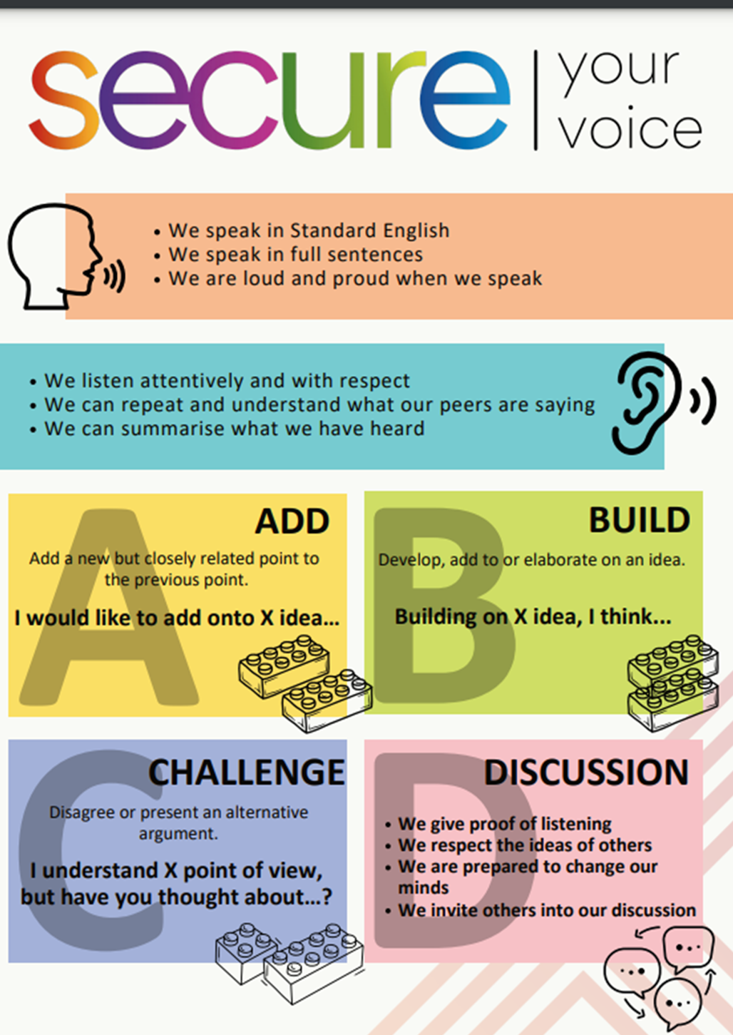
Negative online presence
Using your oracy helpsheet, discuss with the person next to you the question:
“what did you learn from the video?”
Remember to use the sentence starters to add, build or challenge what your partner has said.
Be ready to share your discussion with the class

Slide 12
Equality and Equity
Although equality and equity are similar there are some key differences.
Equality = everyone receiving the same thing regardless of their situation
Equity = everyone receives what they need to succeed

Slide 13
Equality and Equity
Examples of this in school:
Pupils are treated equally as they all get the same amount of time on a test
However, there is also equity when it comes to tests, as those with additional needs may get extra time to complete the test

Slide 14
Hinge Questions – whiteboard activity
3
Rules!
I will ask the question and give you some thinking time. (no more than 10 seconds)
Write the answer and turn your whiteboard over so nobody can see it.
When I am ready I will put on the 3 to 1 counter.
When ‘Show me’ appears on the board you must hold up your whiteboard (even if you don’t know the answer and there is nothing on your board)
2
1
Show me!
(even if your whiteboard is blank)

Slide 15
Hinge Questions – whiteboard activity
What is being described?
“treating everyone the same regardless of their individual needs or circumstances”
Equality

Slide 16
Hinge Questions – whiteboard activity
What is being described?
“giving people the resources they need based on their individual circumstances to achieve the same outcome”
Equity

Slide 17
Hinge Questions – whiteboard activity
What Golden Thread does today’s lesson relate to?
A – Secure your Voice
B – Secure your Relationships
C – Secure your Wellbeing
D – Secure your Future

Slide 18
Hinge Questions – whiteboard activity
True or False
“equality and equity are the same thing”
A – True
B – False

Slide 19
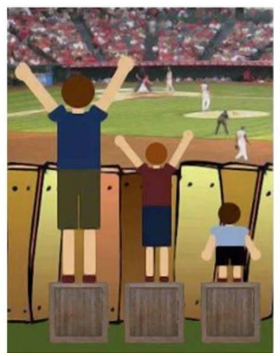
Equality and Equity
In the margin write “SYV” – this stands for “Secure Your Voice”
Highlight “SYV”
Complete the following sentence – “this is an example of equality/equity because…”

Slide 20
Equality vs Equity
Using your oracy helpsheet, discuss with the person next to you the question:
“Did the picture show equality or equity? Why?”
Remember to use the sentence starters to add, build or challenge what your partner has said.
Be ready to share your discussion with the class

Slide 21
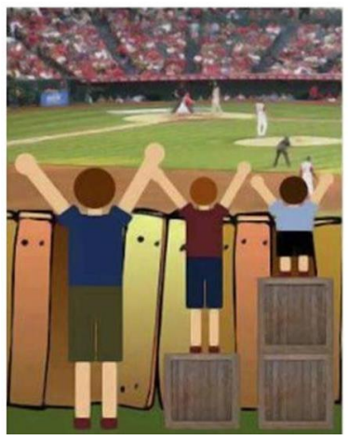
Equality and Equity
In the margin write “SYV” – this stands for “Secure Your Voice”
Highlight “SYV”
Complete the following sentence – “this is an example of equality/equity because…”

Slide 22
Equality vs Equity
Using your oracy helpsheet, discuss with the person next to you the question:
“Did the picture show equality or equity? Why?”
Remember to use the sentence starters to add, build or challenge what your partner has said.
Be ready to share your discussion with the class

Slide 23
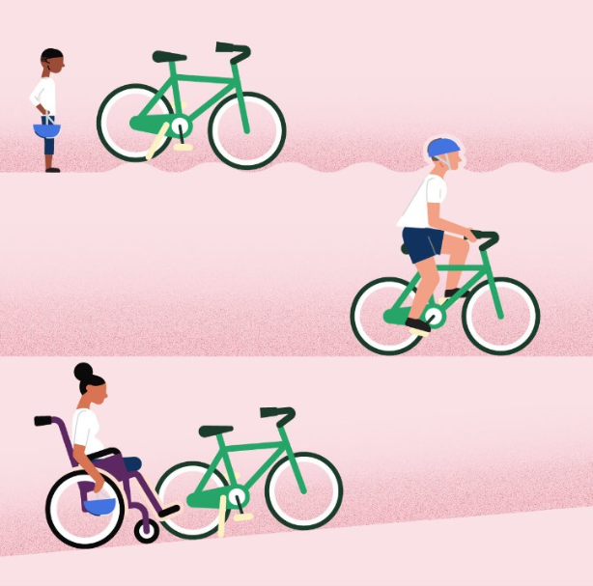
Equality and Equity
In the margin write “SYV” – this stands for “Secure Your Voice”
Highlight “SYV”
Complete the following sentence – “this is an example of equality/equity because…”

Slide 24
Equality vs Equity
Using your oracy helpsheet, discuss with the person next to you the question:
“Did the picture show equality or equity? Why?”
Remember to use the sentence starters to add, build or challenge what your partner has said.
Be ready to share your discussion with the class

Slide 25
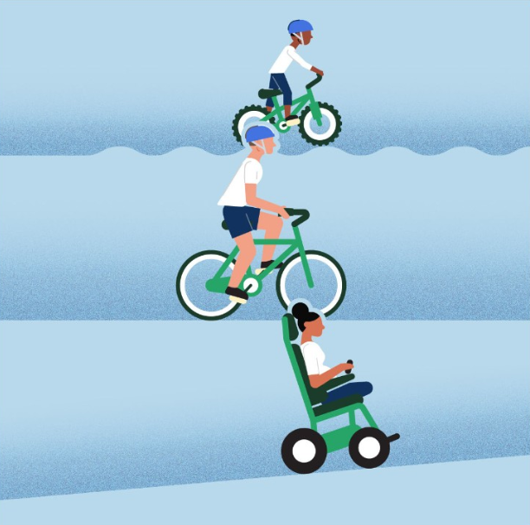
Equality and Equity
In the margin write “SYV” – this stands for “Secure Your Voice”
Highlight “SYV”
Complete the following sentence – “this is an example of equality/equity because…”

Slide 26
Equality vs Equity
Using your oracy helpsheet, discuss with the person next to you the question:
“Did the picture show equality or equity? Why?”
Remember to use the sentence starters to add, build or challenge what your partner has said.
Be ready to share your discussion with the class

Slide 27
Equality and Equity
Although equality and equity have two separate meanings, they work together. This means that one cannot be achieved without the other.
For the world to reach a place where everything is fair, just and equal, equality must be prioritised. Equity is the vehicle to achieving equality.

Slide 28
Hinge Questions – whiteboard activity
3
Rules!
I will ask the question and give you some thinking time. (no more than 10 seconds)
Write the answer and turn your whiteboard over so nobody can see it.
When I am ready I will put on the 3 to 1 counter.
When ‘Show me’ appears on the board you must hold up your whiteboard (even if you don’t know the answer and there is nothing on your board)
2
1
Show me!
(even if your whiteboard is blank)

Slide 29
Hinge Questions – whiteboard activity
Is the below an example of a equality, equity or both
“A school has a school uniform policy that all pupils must follow. However the school appreciate that the uniform can be expensive. There is a fund for families to access if they are struggling financially to purchase the school uniform for their children”
A – Equality
B – Equity
C - Both

Slide 30
Hinge Questions – whiteboard activity
Is the below an example of a equality, equity or both
“The spare kit room in a school’s PE department only has tracksuit bottoms, tshirts and footwear in the one size”
A – Equality
B – Equity
C - Both

Slide 31
Hinge Questions – whiteboard activity
Is the below an example of a equality, equity or both
“The school library has reading books for all different abilities. This includes audiobooks and large print version of books”
A – Equality
B – Equity
C - Both

Slide 32
Hinge Questions – whiteboard activity
Is the below an example of a equality, equity or both
“A school provides after school tuition for their pupils. Anyone can attend but teachers specifically encourage pupils who are struggling the most to attend”
A – Equality
B – Equity
C - Both

Slide 33
Equality and Equity
In the margin write “SYV” – this stands for “Secure Your Voice”
Highlight “SYV”
Complete the following sentences –
“At Hodge Hill College there is equality as….”
“At Hodge Hill College there is equity as…”

Slide 34
Equality vs Equity
Using your oracy helpsheet, discuss with the person next to you the question:
“How does Hodge Hill College show equality and equity?”
Remember to use the sentence starters to add, build or challenge what your partner has said.
Be ready to share your discussion with the class

Slide 35
Support
If you ever need support about equality or equity for yourself, a friend or family member you can find it here:
Childline.org.uk
Call – 08001111
Email or chat online for support
Themix.org.uk
You can email or have one-to-chat online.
There is also a crisis messenger which is available 24/7

