Slide 2
Write the date: 05 November 2024
Write the title: What is mental health?
Underline both!
Complete the following tasks
What does “STI” stand for?
2. Is the conceptive pill a barrier or hormonal method of contraception?
3. True or False – one reason why people sext is due to being pressurised.
Sexually Transmitted Infection
Hormonal
True

Slide 4
Secure your Wellbeing: Learning Journey
What is mental health?
Impact of drugs and alcohol on mental health
What is gambling?
What are eating disorders?
How to deal with emotions?
How to deal with fallouts
Today we will look at:
What is mental health?
This includes:
Misconceptions
Reframing language around mental health
Challenging stigma of mental health
Please remember that during the lesson we should not be asking any pupil or teacher personal questions.
Your teacher can ask you questions but this will be to check your knowledge in the lesson.

Slide 5
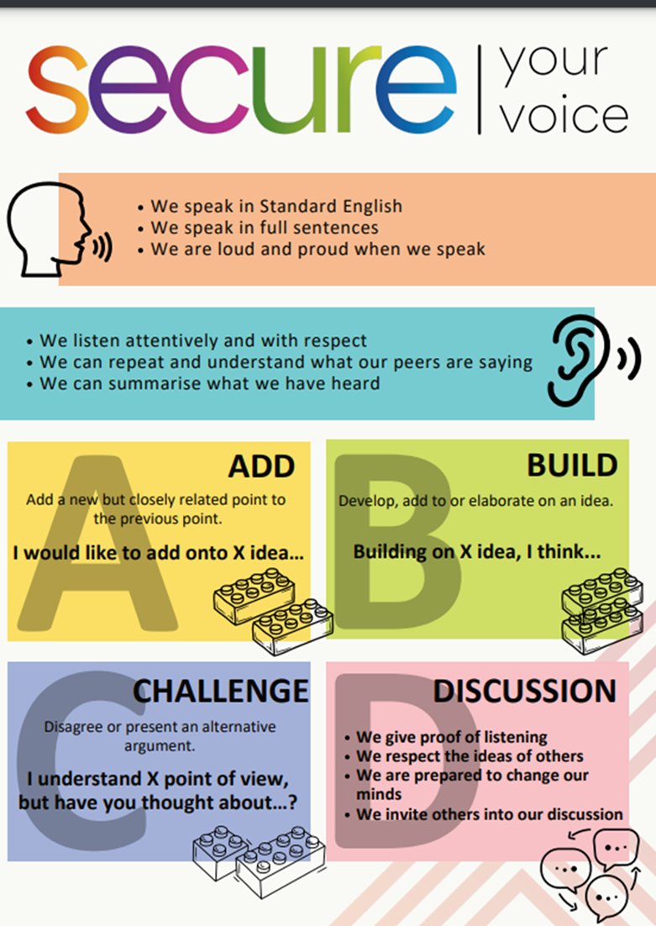
Discussion
In tutor time this week you looked at mental health
With your partner discuss what you can remember from tutor time.
Remember you will need to share your discussion with the class

Slide 6
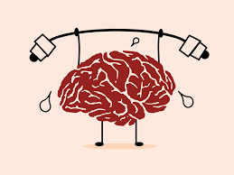
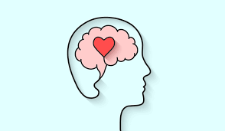
Tutor Time recap
Mental Health is “a state of mental well being that enables people to cope with the stresses of life, realise their abilities, learn well and work well and contribute to their community”
Everyone has mental health regardless if they are feeling good or bad.
Mental health and mental illness are different things
Exercise, staying hydrated, eating healthily, doing things that make you feel good and talking to people are all ways to have good mental health

Slide 7
Talking about mental health
Conversations about mental health have become more common, more open and more positive in recent years.
However there are still lots of misconceptions about mental health.

Slide 8
Talking about mental health - misconceptions
You will be shown a common misconception on the board.
You will discuss with your partner why this is a common misconception and what a reply could be to the misconception.
You must be able to explain your answer

Slide 9
Talking about mental health - misconceptions
“I don’t think mental health is a very big issue”
This is a common misconception. A response to this is…
“Mental health problems are quote common. 1 in 4 adults and 1 in 8 children experience them every year”

Slide 10
Talking about mental health - misconceptions
“I don’t think people with mental health problems are going to be able to lead a full and happy life”
This is a misconception. A response to this is…
“There might be challenges and they might need support but many people can still lead a full and happy life with a mental health condition.”

Slide 11
Talking about mental health - misconceptions
“I think you can tell if someone has a mental health problem by looking at them”
This is a misconception. A response to this is…
“You cannot see a mental health condition by looking at someone and this can make it hard for people to talk about it”

Slide 12
Talking about mental health - misconceptions
“I think everyone has the same chance of developing a mental health problem”
This is a misconception. A response to this is…
“LGBT+ people can face bullying and discrimination which can make them more likely to have a mental health problem”

Slide 13
Talking about mental health - misconceptions
“I think people with mental health problem are violent”
This is a misconception. A response to this is…
“People with mental health issues are no more likely to be violent than anyone else”

Slide 14
Stigma around mental health
Although talking about mental health is promoted, there is still stigma (negative/unfair beliefs people have about something) around mental health.

Slide 15
Stigma around mental health
This means that sometimes people find it difficult to talk about mental health, or might have little understanding of it and can therefore say things that might be unhelpful or offensive to others.
Often this can happen without the person meaning to upset or offend someone

Slide 16
Stigma around mental health
We are now going to look at some comments that can regularly cause unintended offence or upset to someone.
When these comments are said, the person saying them has no idea how people around them could be feeling mentally.

Slide 17
Stigma around mental health
For each comment you will need to come up with an alternative phrase that has the same meaning but might not cause any unintended offence.
Example – “the traffic was crazy this morning”
An alternative comment could have been “the traffic was really busy today”.
This is more appropriate as a person hearing this could be struggling with their mental health and could feel that they are going crazy, even if they do not seem like this on the outside.

Slide 18
Stigma around mental health
Discuss with your partner how the following comment could be rephrased.
“That party was so mental”
Be ready to share your responses with the class

Slide 19
Stigma around mental health
“that party was so mental”
This comment demonstrates the flippant way people can use mental health language. This reinforces the stigma around mental health.
Instead a person could say “that party was so much fun”

Slide 20
Stigma around mental health
Discuss with your partner how the following comment could be rephrased.
“Really? You look fine to me”
Be ready to share your responses with the class

Slide 21
Stigma around mental health
“really? You look fine to me”
This is a common example of a typical responses people with a mental health issue sometimes get from family or friends. This diminishes the issues and minimizes the impact of experiencing a mental health issue.
A way to rephrase this comment is “Really? Is there anything I can do for you?”

Slide 22
Stigma around mental health
Discuss with your partner how the following comment could be rephrased.
“I don’t want to hang out with a weirdo”
Be ready to share your responses with the class

Slide 23
Stigma around mental health
“I don’t want to hang out with a weirdo”
This is an example of a comment that focuses on unhelpful behaviours in relation to mental health, primarily excluding or deliberately trying to upset someone known to have mental health issues
A way to rephrase this comment is “Sorry, I can’t hang out today”

Slide 24
Stigma around mental health
Discuss with your partner how the following comment could be rephrased.
“Man up! Stop being such a drama queen”
Be ready to share your responses with the class

Slide 25
Stigma around mental health
“Man up! Stop being such a drama queen”
This is an example of a comment that includes unhelpful advice that people sometimes receive when discussing a mental health concern
A way to rephrase this comment is “do you want to talk about what you are finding difficult”

Slide 26
Challenging Stigma
The best way to end stigma is to challenge it.
However this can be difficult to do especially with your friends.

Slide 27
Challenging Stigma
With your partner discuss the following question:
“What could be done by individuals or friends to challenge a persons negative attitude to other peoples mental health?”
Be ready to share your ideas with the class

Slide 28
Challenging Stigma
Some ideas to challenge the stigma is:
Avoid using language that might be offensive/upsetting
Challenge this language if they hear it used
Encourage people to be understanding about mental health
Avoid making fun of mental health issues – challenge it if heard said by other people

Slide 29
Challenging Stigma
With your partner discuss the following question:
“What could be done in schools to challenge mental health stigma?”
Be ready to share your ideas with the class

Slide 30
Challenging Stigma
Some ideas to challenge the stigma is:
Teach more about mental health – this is the point of this lesson
Promote sources of support – at Hodge Hill College we promote “telling someone you trust”
Use displays to promote talking about mental health
Have “positive mental health” events
Make all people feel included in the school community.

Slide 31
Challenging Stigma
With your partner discuss the following question:
“what could be done in wider society to challenge stigma around mental health?”
Be ready to share your ideas with the class

Slide 32
Challenging Stigma
Some ideas to challenge the stigma is:
More mental health campaigns
More funding for mental health charities/services
Stronger laws about discrimination against people with mental health concerns
Mental health support in all workplaces for adults
Encourage openness around mental health issues in shared areas such as religious buildings, Community Centres etc

Slide 33
Hinge Questions – whiteboard activity
3
Rules!
I will ask the question and give you some thinking time. (no more than 10 seconds)
Write the answer and turn your whiteboard over so nobody can see it.
When I am ready I will put on the 3 to 1 counter.
When ‘Show me’ appears on the board you must hold up your whiteboard (even if you don’t know the answer and there is nothing on your board)
2
1
Show me!
(even if your whiteboard is blank)

Slide 34
Hinge Questions – whiteboard activity
What is being described?
“a state of mental well being that enables people to cope with the stresses of life, realise their abilities, learn well and work well and contribute to their community”
Mental health

Slide 35
Hinge Questions – whiteboard activity
Could the following statement cause unintended upset or offensive to someone struggling with their mental health?
“isn’t depression the same as just being a bit sad”
Yes – this diminishes how that person is currently feeling

Slide 36
Hinge Questions – whiteboard activity
Could the following statement cause unintended upset or offensive to someone struggling with their mental health?
“that is a real first world problem. Some people have bigger problems”
Yes – this diminishes how that person is currently feeling regardless of how others see the problem

Slide 37
Hinge Questions – whiteboard activity
If a person hears language that makes fun of mental health, what could they do about it?
Challenge the use of the language

Slide 38
Support
If you ever need support about mental health for either yourself or a friend/family member, you can get support from the following places
Childline.org.uk
Call – 08001111
Email or chat online for support
Themix.org.uk
You can email or have one-to-chat online.
There is also a crisis messenger which is available 24/7

