Slide 2
Write the date: 25 September 2024
Write the title: Media and relationships
Underline both!
Complete the following tasks (if you haven’t done so already):
Put together your exercise book
Plastic cover
White paper at the back for your mini whiteboard
Golden thread sticker on the front
Write your full name, Personal Development and your class name on the front of your book

Slide 4
Secure your Future: Learning Journey
Impact of the media on relationships
What is consent in romantic relationships
What is the impact of pornography?
What is sexting and the law?
What is contraception
What are STI’s?
Today we will look at:
Impact of the media on romantic relationships
This includes:
Qualities of a good relationship
Media impact on learning about relationships
Please remember that during the lesson we should not be asking any pupil or teacher personal questions.
Your teacher can ask you questions but this will be to check your knowledge in the lesson.

Slide 5
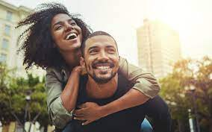
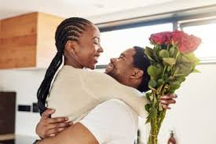
Romantic relationships
During tutor time this week you learnt about what the difference is between romantic relationships and friendships.
What can you remember from Tutor Time?

Slide 6
Romantic relationships
The definition of romantic relationship is…
“any relationship between people with a desire to be intimate with each other. Both parties must feel an attraction to each other”
It is the keywords intimate and attraction that differentiate a romantic relationship and a friendship

Slide 7
What does intimate and attraction mean?
Intimate in this context means that people wish to have a physical connection with each other.
This can include holding hands, hugging, kissing and other sexual behaviours
Attraction in this context means that people wants to have romantic interactions with another person.
This is why it is important that both people feel this attraction.

Slide 8
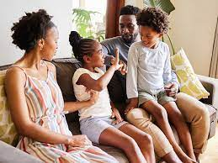
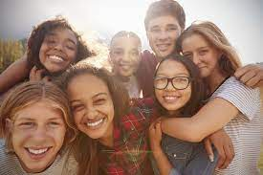
What is a healthy relationship?
Before looking into the media’s portrayal of relationships it is important to look at what makes a relationship healthy.
There are many things that make a relationship healthy. Some principles are:
Communication
Respect
Trust
equality

Slide 9
What is a healthy relationship?
Turn and Talk - with a partner match up each principle with its definition
Communication
Each person in the relationship is equal to each other. There is no power imbalance
Respect
Each person treats the other the way they should be treated
Trust
There is clear communication between people so everyone knows what the other is thinking
Equality
Tell each other the truth and there are no secrets in the relationship

Slide 10
Learning about relationships
If a person has not been in a relationship, they can learn about what to expect from relationships from different sources that can give accurate information:
Friends
Family
Personal Development lessons
However one of the other main ways people “learn” about relationships is through the media. This can be through:
Magazines
Social Media
TV shows/adverts
Films

Slide 11
Analysing media relationships?
Relationships within the media can often be:
Unhealthy – they do not always show the principles we discussed earlier
Unrealistic – may not always happen in real life

Slide 12
Analysing media relationships?
Shows the principles of a healthy relationship and could happen in real life
Shows the principles of an unhealthy relationship that could happen in real life
Shows the principles of a healthy relationship but would not happen in real life
Shows the principles of an unhealthy relationship that would not happen in real life

Slide 13
Relationship scenarios
Where would you put this scenario on the diagram? Be ready to share your reason why?
“A high school teen drama shows the captain of the football team and the most popular girl go to their school prom together. At prom they win “prom king and queen”. At the end of the movie it shows them in the future. They are married, live in a huge house and have 3 children”

Slide 14
Relationship scenarios
Where would you put this scenario on the diagram? Be ready to share your reason why?
“On Love Island is a reality TV programme that requires people to “couple up” to remain on the show and potentially win a cash prize. In one episode, it is announced that 2 people will be voted off the show. Two people on the show declare that they love each other so it increases their chances of not being voted off and closer to winning the cash prize at the end of the show”

Slide 15
Relationship scenarios
Where would you put this scenario on the diagram? Be ready to share your reason why?
“In a movie, the King decides that his Princess daughter should get married. To decide who will marry his daughter he calls out a contest were different men duel with each other. The King announces that the winner of the duel will marry the Princess.”

Slide 16
Relationship scenarios
Where would you put this scenario on the diagram? Be ready to share your reason why?
“A family sitcom is based around a family. The family is made up of 2 adults and 2 children. Throughout the series it shows times were the mum and dad are kind to each other but also times when they argue with each other. After arguments it shows that they make up by talking and apologising for things they may have said”

Slide 17
Analysing media relationships
Really there are very few examples of healthy and realistic relationships in the media. This is because…
They are over dramatised to make them interesting and exciting to watch
People of reality TV programmes act differently because of the cameras or alternative motives (fame, winning)
Relationships move on very quickly – this can give people inaccurate expectations
Desensitise issues in relationships likes arguments, multiple break ups and cheating. This can give people the impression that these issues are normal in relationships

Slide 18
Relationship Myths in the media
Watching, and believing what is portrayed in the media can encourage people to believe some myths about relationships.

Slide 19
Relationship Myths in the media
Common myths are:
It is typical to fall in love at first sight
Characters who fall in love start of hating each other
Most relationships involve dramatic arguments where lots of friends get involved
Grand, romantic gestures help to win over someone who is not interested
Most relationships include lots of break up and getting back to together several times
Kissing usually leads to other sexual behaviour very quickly

Slide 20
Relationship Myths in the media - task
Common myths are:
It is typical to fall in love at first sight
Characters who fall in love start of hating each other
Most relationships involve dramatic arguments where lots of friends get involved
Grand, romantic gestures help to win over someone who is not interested
Most relationships include lots of break up and getting back to together several times
Kissing usually leads to other sexual behaviour very quickly
Task
Working with a partner, in your books you are going to choose 2 myths and answer the following question
“How is likely to be different in real life healthy relationships?

Slide 21
Relationship Myths in the media - task
Common myths are:
It is typical to fall in love at first sight
Characters who fall in love start of hating each other
Most relationships involve dramatic arguments where lots of friends get involved
Grand, romantic gestures help to win over someone who is not interested
Most relationships include lots of break up and getting back to together several times
Kissing usually leads to other sexual behaviour very quickly
Example answer
I have chosen the myth that it is typical to fall in love at first sight
In a real life relationship many people get to know each other before deciding if they love the other person. It does not happen when they first set eyes on each other.

Slide 22
Relationship Myths in the media - task
Common myths are:
It is typical to fall in love at first sight
Characters who fall in love start of hating each other
Most relationships involve dramatic arguments where lots of friends get involved
Grand, romantic gestures help to win over someone who is not interested
Most relationships include lots of break up and getting back to together several times
Kissing usually leads to other sexual behaviour very quickly
Task
Choose 2 myths and complete the following sentences in your books.
The myth I have chosen is…
In a real life relationship…
Be ready to share your answers with the class

