Slide 2
Write the date: 17 May 2024
Write the title: Introduction to contraception
Underline both!
Complete the do now task:
True or False – it is illegal to have a nude image of someone under 18 even if they sent it without asking
2. Give an example of a relationship myth from the media
3. True or False – actors in pornography may have had surgery so they can have a more “ideal” sexual body?
true
Falling in love at first sight, people hate each other before falling in love, relationships involve dramatic arguments that include friends, romantic gestures always win people over, most relationships include multiple breakups and getting back together, kissing quickly leads to other sexual behaviours
True

Slide 4
Secure your relationships: Learning Journey
Introduction to healthy relationships
What is gender identity and sexual orientation?
What are romantic relationships?
What is consent?
Sexting and the law
What is contraception?
Review
Today we will look at:
What is contraception
This includes:
Names of different contraception methods
What type of method each contraception is
How it works
The effectiveness of each contraception type
Please remember that we should not be asking anyone in the class or the teacher personal questions.
The teacher may ask you questions about content in the lesson but this will never be about your personal experiences.

Slide 5
What is our starting point?
In your books complete the following sentence
At the beginning of the lesson different types of contraception I know are…

Slide 6
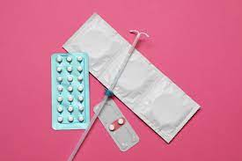
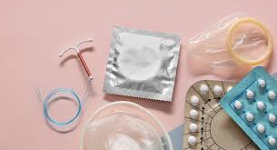
What is contraception?
The definition of contraception is…
“a method or technique used to prevent pregnancy and reduce the risk of spreading STIs as a result of having sex”

Slide 7
What is contraception?
This definition shows that there are 2 main reasons why people use contraception:
To avoid unwanted pregnancy
To reduce the risk of transmitting/catching a STIs
STI stands for “sexually transmitted infection” you will learn more about this in Year 9

Slide 8
What types of contraception are there?
There are more than 12 different types of contraception. However today we are focusing on:
Male condoms
Femidoms (female condoms)
Contraceptive pill
Contraceptive injection

Slide 9
What types of contraception are there?
When discussing these 4 different types of contraception we will cover the following information:
Name of the contraception
Is it designed for male or female use?
Is it a barrier or hormonal method of contraception?
How it works?
How effective is it at stopping pregnancy?

Slide 10
What types of contraception are there?
Before we starting looking at the different types of contraception it is important to clarify what is meant by “barrier” or “hormonal” methods.
Barrier method means that the contraception stops sperm from entering the body
Hormonal method means that hormones are used to alter the internal workings of the female body to prevent pregnancy.

Slide 11
What types of contraception are there?
Before we starting looking at the different types of contraception it is important to clarify what is meant by “barrier” or “hormonal” methods.
Barrier method means that the contraception stops sperm from entering the body
Hormonal method means that hormones are used to alter the internal workings of the female body to prevent pregnancy.

Slide 12
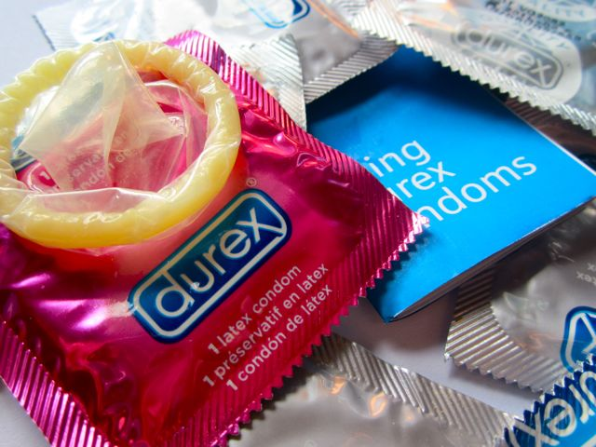
Condoms
This is one of the most common methods of contraception. This is shown by 160 million condoms being purchased every year in the UK.
They are designed for male use
Condoms work as they cover the penis with a thin layer of latex during sex. This means that the condom catches sperm and prevents it from meeting the egg. This means it is a barrier method of contraception.
Condoms are effective between 82%-98% of the time in preventing pregnancy. Reasons why condoms may not be effective is that they are not put on properly, they are out of date or they rip during sex.

Slide 13
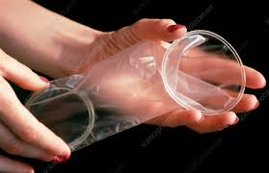
Femidoms (female condom)
Femidoms are a female equivalent to male condoms. However they are not as commonly used.
They are designed for female use
Femidoms are made from soft, thin polyurethane and it is worn inside of the vagina.
They stop pregnancy by stopping sperm from entering the uterus. This means it is a barrier method of contraception.
Femidoms are effective in stopping pregnancy 79%-92% of the time. Reasons why they lose effectiveness is misuse in putting the femidom in place and they may slip out during sex.

Slide 14
Contraceptive Pill
This is another very popular form of contraception with approximately 3.1 million women in UK taking the contraceptive pill.
This is designed for female use.
It works by a female taking one small tablet every day. It stops pregnancy by stopping the female body from releasing an egg each month. This means it is a hormonal contraceptive method.
The contraceptive pill is effective in stopping pregnancy 91%-99% of the time. Reasons why it may not be effective is due to forgetting to taking a tablet every day.

Slide 15
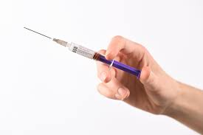
Contraceptive Injection
This is designed for female use.
This works by females being given an injection every 3 months. It stops the female body from producing an egg each month. This means it is a hormonal contraceptive method.
It is effective in stopping pregnancy 94%-99% of the time. One reason why it can lose effectiveness is not getting an injection within 3 months of the last injection.

Slide 16
Hinge Questions – whiteboard activity
3
Rules!
I will ask the question and give you some thinking time. (no more than 10 seconds)
Write the answer and turn your whiteboard over so nobody can see it.
When I am ready I will put on the 3 to 1 counter.
When ‘Show me’ appears on the board you must hold up your whiteboard (even if you don’t know the answer and there is nothing on your board)
2
1
Show me!
(even if your whiteboard is blank)

Slide 17
Hinge Questions – whiteboard activity
What is being defined below?
“a method or technique used to prevent pregnancy and reduce the risk of spreading STIs as a result of having sex”
Contraception

Slide 18
Hinge Questions – whiteboard activity
What type of contraceptive method is being described?
“stopping sperm from entering the body”
Barrier

Slide 19
Hinge Questions – whiteboard activity
What type of contraceptive method is being described?
“use of hormones to alter the internal workings of the female body to prevent pregnacy”
Hormonal

Slide 20
Hinge Questions – whiteboard activity
What type of contraception method is being described?
“designed for male use. A thin layer of latex covers the penis to catch sperm and prevent it from meeting the egg”
A – Condom
B- Femidom
C – Contraceptive Pill
D – Contraceptive Injection

Slide 21
Hinge Questions – whiteboard activity
What type of contraception method is being described?
“designed for female use. A small tablet has to be taken everyday as this stops the female body from producing an egg every month”
A – Contraceptive injection
B- Femidom
C – Condom
D – Contraceptive Pill

Slide 22
Hinge Questions – whiteboard activity
What type of contraception method is being described?
“designed for female use. An injection is given every 3 months and it stops the female body from producing an egg every month”
A – Contraceptive Pill
B- Condom
C – Contraceptive injection
D – Femidom

Slide 23
Hinge Questions – whiteboard activity
What type of contraception method is being described?
“designed for female use. This is made from soft, thin polyurethane and is worn inside the vagina to stop sperm from entering the uterus”
A – Contraceptive Injection
B- Femidom
C – Contraceptive Pill
D – Condom

Slide 24
Card Sort Activity
Working with a partner sort the cards out into correct order.
Each pile of cards contains all the information covered in today’s lesson.
The order you should put the cards is
Name
Picture
Is designed for male or female use
Is it a barrier or hormonal method of contraception?
How it works?
How effective is it at stopping pregnancy?

Slide 25
Card Sort Answers
Condoms
They are designed for male use
This means it is a barrier method of contraception.
Condoms work as they cover the penis with a thin layer of latex during sex. This means that the condom catches sperm and prevents it from meeting the egg.
Condoms are effective between 82%-98% of the time in preventing pregnancy.

Slide 26
Card Sort Answers
Femidoms
They are designed for female use
This means it is a barrier method of contraception.
They are made from soft, thin polyurethane and it is worn inside of the vagina. They stop pregnancy by stopping sperm from entering the uterus.
Femidoms are effective in stopping pregnancy 79%-92% of the time.

Slide 27
Card Sort Answers
Contraceptive Pill
They are designed for female use
This means it is a hormonal method of contraception.
It works by a female taking one small tablet every day. It stops pregnancy by stopping the female body from releasing an egg each month
The contraceptive pill is effective in stopping pregnancy 91%-99% of the time.

Slide 28
Card Sort Answers
Contraceptive Injection
They are designed for female use
This means it is a hormonal method of contraception.
This works by females being given an injection every 3 months. It stops the female body from producing an egg each month.
It is effective in stopping pregnancy 94%-99% of the time.

Slide 29
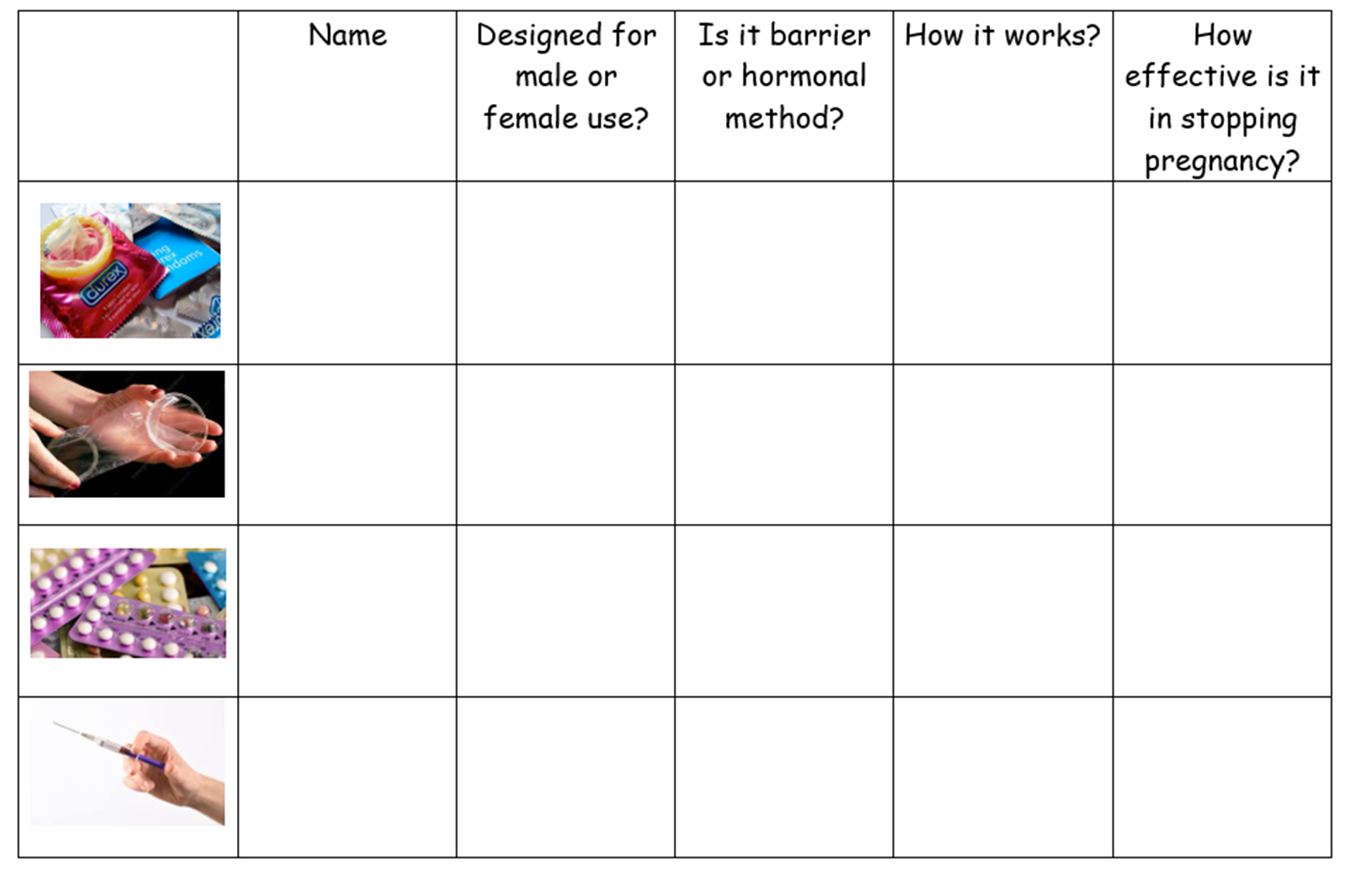
Independent Task
Using the card sort you must now complete the worksheet.
Once you have completed the worksheet this should be stuck into your book

Slide 30
Reflection
In your books complete the following sentences
One type of contraception I learnt about today that I have never heard of was…
One fact about this type of contraception is…

