Slide 1
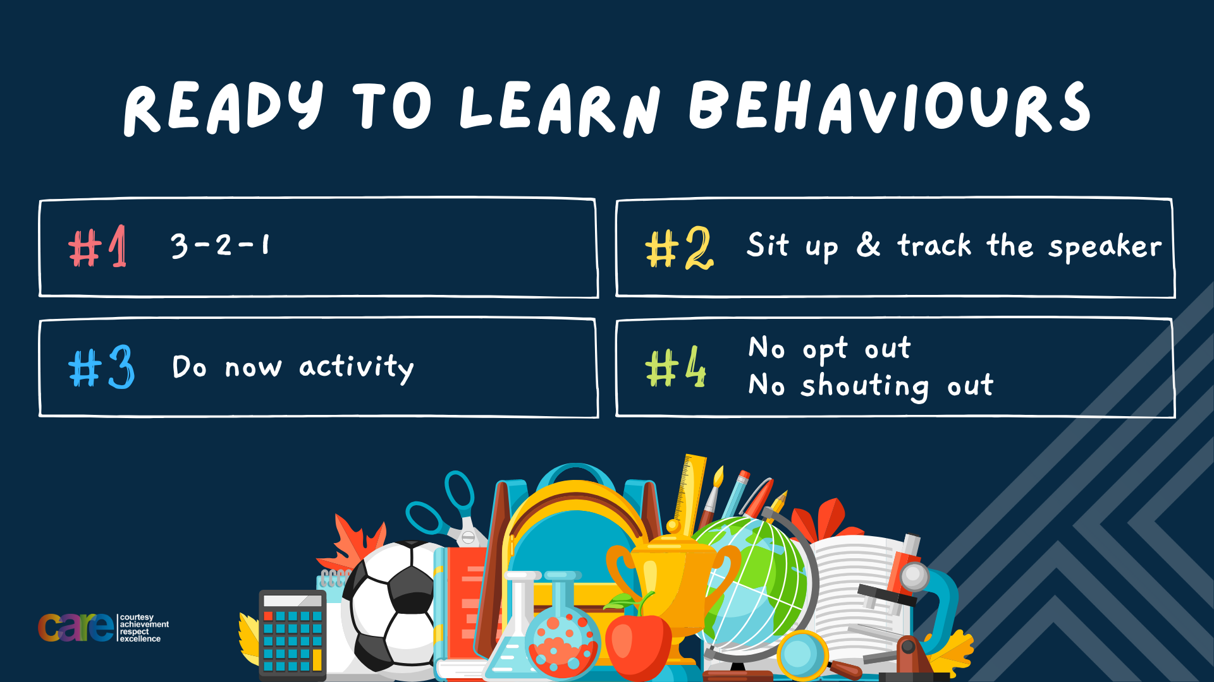

Slide 2








Write the date: 14 June 2024
Write the title: What are laws?
Underline both!
Complete the following tasks:
What does MP stand for?
A MP represents an area. What is another word for this area?
Name a political party in the UK.
Member of Parliament
Constituency
Conservatives, Labour, Liberal Democrats, Green Party, Sinn Fein, DUP, Scottish Nationalist Party, Plaid Cymru, Reform UK

Slide 3


Slide 4


Secure your Future: Learning Journey
Political Parties in the UK
What is a MP?
What are laws and how are they made?
Who is running for election in Hodge Hill?
What does individual liberty mean?
Tolerance, respect and diversity. How do these link?
Summer holidays
Today we will look at:
What are laws and how are they made?
This includes:
Why do we need laws?
How are laws made?
What laws you would like created
Please remember that your teacher cannot answer any questions about the political party they support or who they will be voting for in the General Election.

Slide 5


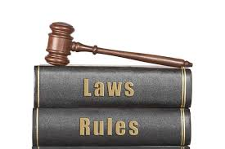
What if there were no rules or laws?
Turn and Talk Task
With the person next to you discuss the following:
“If the UK had no laws what would you do? What could you do that you didn’t before because of the law?”
Example – people might want to drive faster than 70mph on the motorway so they would get rid of the speed limit laws so they could drive their cars/motorbikes faster

Slide 6
What if there were no rules or laws?
Turn and Talk Task
With the person next to you discuss the following:
“If the UK had no laws what would you do? What could you do that you didn’t before because of the law?”
Remember though that it is not just you that is free from the rules and laws – everyone would be free from the law.
Be ready to share your ideas

Slide 7
Why we need laws
Without laws we would live in fear. The strongest or most powerful people would control our society. So there is a system of laws to protect you and your rights

Slide 8
What is a law?
The law is…
“a system of rules that a country have agreed to follow”
Laws regulate people’s actions so if they break the law there could be penalties.

Slide 9
Is the law the same everywhere?
Each country has it’s own laws that everyone has to obey.
This includes visitors to that country

Slide 10
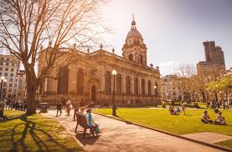
Examples of how laws can be different to what we have in the UK?
One of the most visited places in Birmingham is St Philips Cathedral Churchyard. This is commonly known as “Pigeon Park” because of all the pigeons. Children can often be seen feeding the pigeons in the park.
However in Venice, Italy it is against the law to feed pigeons. It is also against the law to feed pigeons in Trafalgar Square in London too. People can be fined if they are caught feeding the pigeons.

Slide 11
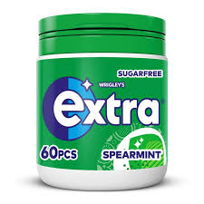
Examples of how laws can be different to what we have in the UK?
The UK is the second biggest consumer of chewing gum in the world. Over £356 million is spent on chewing gum every year
However chewing gum is illegal in Singapore and you can be fined for chewing gum especially if it is outdoors or on their transport system.

Slide 12
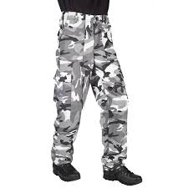
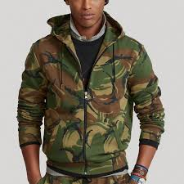
Examples of how laws can be different to what we have in the UK?
In the UK a quick search on any popular clothing website you can purchase many different items in a camouflage print
However in Barbados it is illegal for anyone (including children) to wear any item of clothing that has camouflage print

Slide 13
Is the law the same everywhere?
Turn and Talk Task
Do you agree that laws should also apply to visitors?
Be ready to share your answers with the class

Slide 14
Knowing and respecting the law
It is everyone’s responsibility to know what the law says and to obey it.
Ignorance (saying “I didn’t know”) of the law is not regarded as a valid excuse if a person is found breaking the law

Slide 15
How are laws made?
In the UK it is up to the government to make laws.
However it is not as simple as the Prime Minister deciding something is now a law.
There is a process that has to be followed

Slide 16

How are laws made?
You have been given a worksheet with each step of the law making process. While watching the video you should write a number beside each step.
Example – The first step is “a bill is put forward” beside this is “1”
Label the next steps using numbers between 2 and 7
Notes:
https://www.youtube.com/watch?v=iM4CKYCrW7Y

Slide 17
How are laws made?
The first step is
“A bill is put forward”
This can be by a range of people or groups. The bill could be to propose a new law or to amend an existing law

Slide 18
How are laws made?
The second step is
“A green paper is published”
This presents the Governments ideas for the bill and it is open to the public to discuss. This is called a public consultation.

Slide 19
How are laws made?
The 3rd step is
“A white paper is published”
This includes finding from the public consultation and outlines the proposed bill in more detail than the green paper

Slide 20
How are laws made?
The 4th step is
“Government ministers must agree if the proposal is taken forward”
Government ministers are MP’s who are part of the Prime Ministers closest team. An easy way to think about this is SLT teachers support Mrs Herrmann. Government ministers have the same role for the Prime Minister.
These Government ministers have to agree that the proposal should be taken forward

Slide 21
How are laws made?
The 5th step is
“The bill is presented to Parliament”
The Government Minister responsible for the area that will be impacted by the new or changed law presents it to all MP’s in the House of Commons.

Slide 22
How are laws made?
The 6th step is
“MPs in the House of Commons and the House of Lords debate the bill”
This can happen multiple times as both the House of Commons and House of Lords can make changes to the proposal. Before it goes any further both the House of Commons and House of Lords have to agree on all changes.

Slide 23
How are laws made?
The 7th step is
“Passed to Monarch for formal approval”
The King is given a copy of the bill. Once they have approved it this is now law which is called an Act of Parliament

Slide 24
Hinge Questions – whiteboard activity
3
Rules!
I will ask the question and give you some thinking time. (no more than 10 seconds)
Write the answer and turn your whiteboard over so nobody can see it.
When I am ready I will put on the 3 to 1 counter.
When ‘Show me’ appears on the board you must hold up your whiteboard (even if you don’t know the answer and there is nothing on your board)
2
1
Show me!
(even if your whiteboard is blank)

Slide 25
Hinge Questions – whiteboard activity
What is being described – “a system of rules that a country have agreed to follow”
Law

Slide 26

Hinge Questions – whiteboard activity
True or False
Laws are the same in every country
True
False

Slide 27
Hinge Questions – whiteboard activity
True or False
If you break the law in another country but it is not against the law in the country you are from, you will not be penalised
True
False

Slide 28
Hinge Questions – whiteboard activity
Who gives final approval of the bill before it becomes law?
A – Prime Minister
B – Any MP
C – The King

Slide 29
Task
If you could put forward a bill in order to amend a school rule or bring in a new rule what would you suggest?
In your books complete the following sentences.
A new rule I would like to suggest is…or A rule I would like to change is….
I am suggesting this because….
I think this would benefit HHC pupils because…
Be ready to share your suggestions with the class

Slide 30
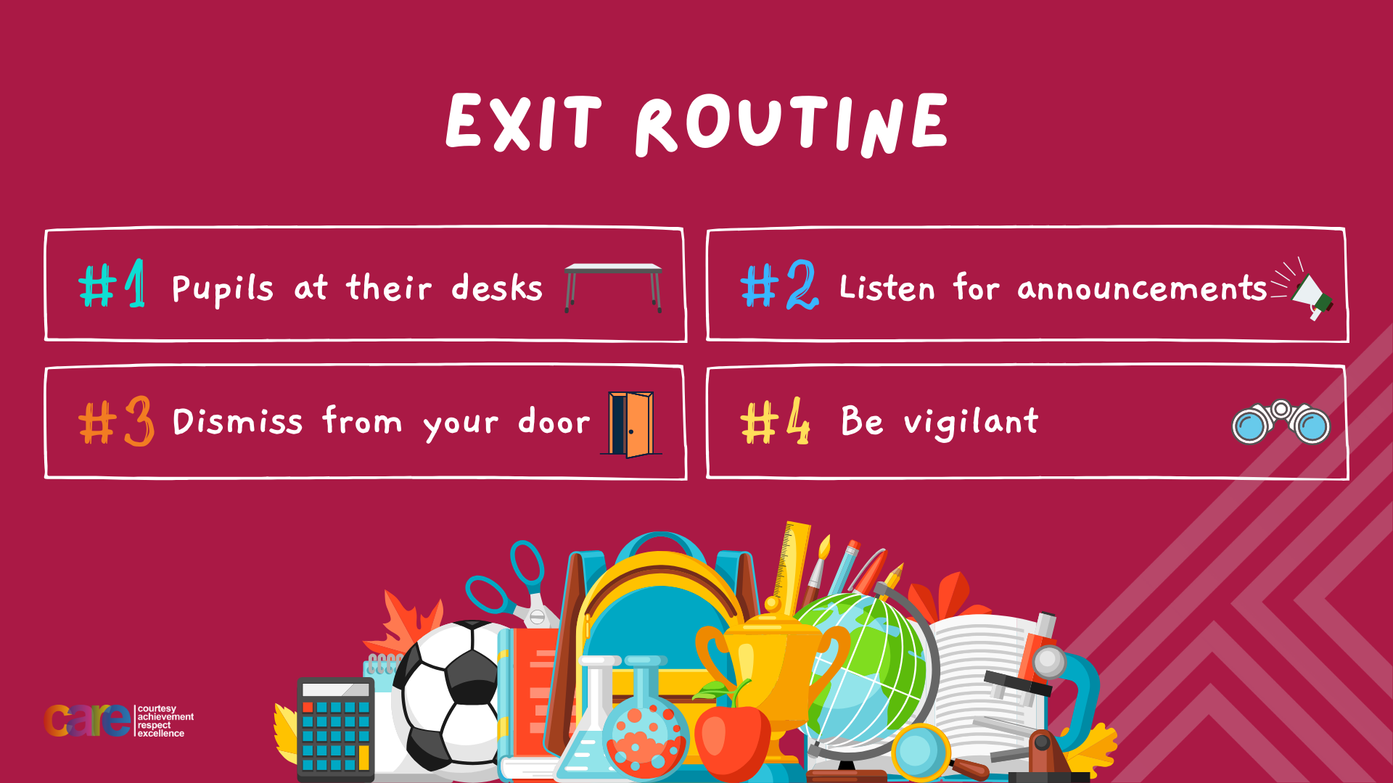

Slide 31
