Slide 1
Remember to complete all homework tasks on SAM Learning
Make sure you are completing the SET TASKS! These are the tasks your teachers have set.
Homework Club every morning in West Canteen from 8am
Library is open before school and at break times
Students on the following slides have incomplete Homework Tasks
Following students have not competed their Homework. This needs to be completed as soon as possible. Students will be put into a detention if they continue to not complete homework and phone calls will be made to parents.
Notes:
Please give time for the students to produce answers for themselves before showing answers.

Slide 2
“Proper nutrition and hydration are the keys to unlocking your body's full potential. Fuel it well, and it will take care of you”

Slide 4
Secure your Future: Learning Journey
Making new friends
Road Safety
What is resilience
Healthy food choices
Importance of sleep
Importance of physical activity
Today we will look at:
Healthy food choices
This includes:
What is water
Why is it good for you
How much water should you drink
Please remember that during the lesson we should not be asking any pupil or teacher personal questions.
Your teacher can ask you questions but this will be to check your knowledge in the lesson.

Slide 5
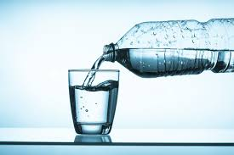
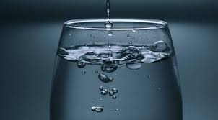
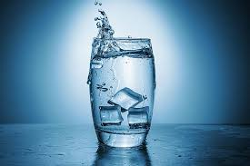
What is water?
Water is a simple, clear liquid that our bodies cannot live without.
This is because 60% of the body are made out of water.
Included in this is the brain. The brain is around 75% water.

Slide 6
What do you know quiz
Is the below statement True or False?
“Not drinking enough water makes you tired”
True – water gives the body power so without it a person will feel tired

Slide 7
What do you know quiz
Is the below statement True or False?
“Water keeps the brain working well”
True – as the brain is approximately 75% water, staying hydrated means the brain works better. This allows for people to pay attention in lessons better and remember things.

Slide 8
What do you know quiz
Is the below statement True or False?
“Water helps the body cool down”
True – if a person is playing sport or exercising, water can help them cool down. The purpose of sweat (which is water from the body) is to help cool the body down.

Slide 9
What do you know quiz
Is the below statement True or False?
“drinking too much water makes your face spotty”
False – water keeps the skin looking healthy and feeling fresh. It also stops skin becoming dry and itchy.

Slide 10
Importance of hydration
Questions
How much water should a person drink to stay hydrated?
Should a person only drink water when they are thirsty?
What is the most reliable way to judge if a person is hydrated?
Notes:
https://www.youtube.com/watch?v=qQjd_ypI9gI

Slide 11
Answers
Questions
How much water should a person drink to stay hydrated?
8 glasses per day
Should a person only drink water when they are thirsty?
No – drinking when thirsty means they are already dehydrated
What is the most reliable way to judge if a person is hydrated?
The colour of their pee

Slide 12
Best time to drink water
Although people should be drinking regularly throughout the day there are certain times when drinking water is important.
Mornings – start they day with a glass of water to wake the body up
Before & after sports/exercising – drink before and after sports/exercising to stay energised. Playing sport or exercising while dehydrated will mean that a person will tire quicker
With meals – drinking water while eating lunch and dinner helps the body to digest the food being eaten
During the school day – regular sips of water throughout the day keeps the brain sharp and alert during lessons

Slide 13
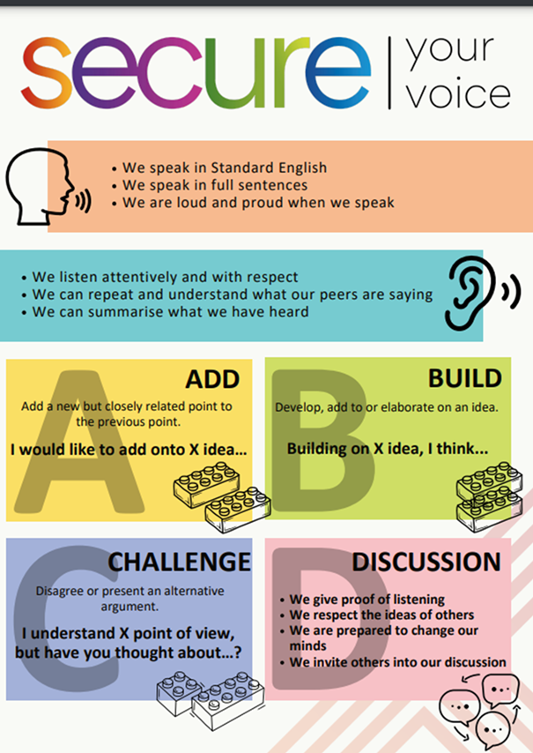
Do you drink enough water?
Using your oracy helpsheet, discuss with the person next to you:
“How much water do you drink a day? Do you think you drink enough?”
Remember we are sharing our ideas to the class and following all the advice on the oracy helpsheet.

