Slide 2
Thought of the Day
“Politics is the art of making your voice heard”
Harriet Harman

Slide 3
Secure your Future: Learning Journey
What is democracy?
Political Parties in the UK
What are laws?
How did the General Election work?
What do MP’s do everyday?
What would you do as a MP?
Today we will look at:
Political parties in the UK
This includes:
Names of political parties across the UK
Please remember that during the lesson we should not be asking any pupil or teacher personal questions.
Your teacher can ask you questions but this will be to check your knowledge in the lesson.

Slide 4
Why are we learning about this?
It is important to learn about how politics works in the UK at a young age.
Despite you not being old enough to vote, it is important to learn about this now so that when you are 18 you are equipped with the knowledge and understanding to vote for a political party that has the same beliefs and values as you

Slide 5
Why are we learning about this?
Democracy is a British Value that we learn about before half term. This mean “rule by people” as this happens by people being able to freely vote for a political party to represent them in Government

Slide 6
Why are we learning about this?
Article 12 states that Governments should have respect for children’s views. Although children cannot vote, many political parties make decisions that impact the lives of children. Children can express their views in many ways to political parties such as writing to the local MP.
UN Rights
of a Child

Slide 7
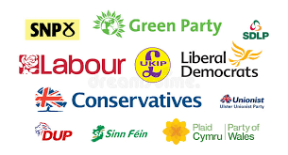
What is a political party?
A political party is defined as…
“An organised group of people who share common beliefs, ideas and views about how society can develop for the benefit of everyone”

Slide 8
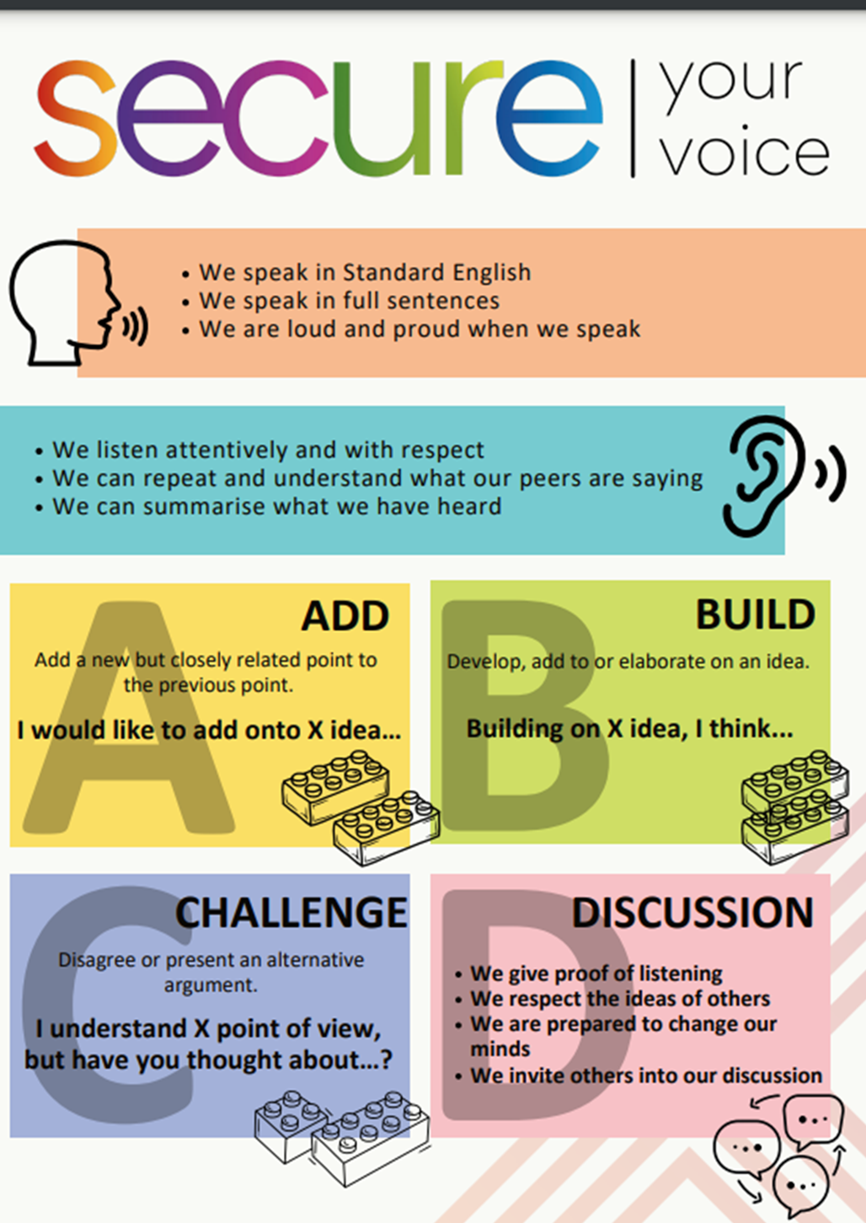
What political parties do you know?
Take out your oracy helpsheet from your learning wallet.
You have 1 minute to think about the following question:
“What political parties do you know in the UK?”

Slide 9
What political parties do you know?
Using your oracy helpsheet, with the person next to you, discuss your response to the question:
“What political parties do you know in the UK?”
Remember to use the sentence starters to add, build or challenge what your partner has said.
Be ready to share your discussion with the class

Slide 10
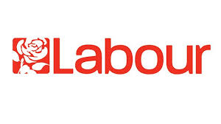
Political parties in the UK
In the UK there are currently around 350 registered political parties. However there are 2 main political parties:
The Labour Party is currently the political party in charge of the UK Government as they have the majority of MP’s in Government

Slide 11
Political parties in the UK
In the UK there are currently around 350 registered political parties. However there are 2 main political parties:
The Conservative Party – They are currently the 2nd biggest political party. This means they are known as the “opposition” in the UK Government

Slide 12
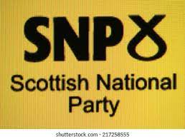
Other Political parties in the UK
Other political parties in the UK include:
Democratic Unionist Party

Slide 13
Other Political parties in the UK
It is important to remember that the UK is made up of 4 countries:
1. England
2. Scotland
3. Wales
4. Northern Ireland
Some of the political parties are found in all 4 parts of the UK, others are only focused on one part of the UK

Slide 14
Other political parties in the UK
With the person next to you decide where the political parties are located in the UK. There is more than 1 answer for some political parties
England
Democratic Unionist Party
Scotland
Wales
Northern Ireland

Slide 15
Other political parties in the UK
With the person next to you decide where the political parties are located in the UK. There is more than 1 answer for some political parties
England
Democratic Unionist Party
Scotland
Wales
Northern Ireland

Slide 16
Other political parties in the UK
With the person next to you decide where the political parties are located in the UK. There is more than 1 answer for some political parties
England
Democratic Unionist Party
Scotland
Wales
Northern Ireland

Slide 17
Other political parties in the UK
With the person next to you decide where the political parties are located in the UK. There is more than 1 answer for some political parties
England
Democratic Unionist Party
Scotland
Wales
Northern Ireland

Slide 18
Other Political parties in the UK
You will be learning much more about the political parties in the UK during your Personal Development lesson this week.
Until then listen and watch out for political parties on the news. What things are you hearing about them?

