Slide 1
Remember to complete all homework tasks on SAM Learning
Homework Club every morning in West Canteen from 8am
Library is open before school and at break times
Students on the following slides have incomplete Homework Tasks
Make sure you are completing the SET TASKS! These are the tasks your teachers have set.
Following students have not competed their Homework that was due on Monday 23rd September. This needs to be completed as soon as possible. Students will be put into a detention if they continue to not complete homework and phone calls will be made to parents. You have til Thursday to complete.
Notes:
Please give time for the students to produce answers for themselves before showing answers.

Slide 2
“Life might not get easier, but we get stronger every time we try again”

Slide 4
Secure your Future: Learning Journey
Making new friends
Road Safety
What is resilience
Healthy food choices
Importance of sleep
Importance of physical activity
Today we will look at:
Resilience
This includes:
What does resilience mean?
Why is resilience important?
Please remember that during the lesson we should not be asking any pupil or teacher personal questions.
Your teacher can ask you questions but this will be to check your knowledge in the lesson.

Slide 5
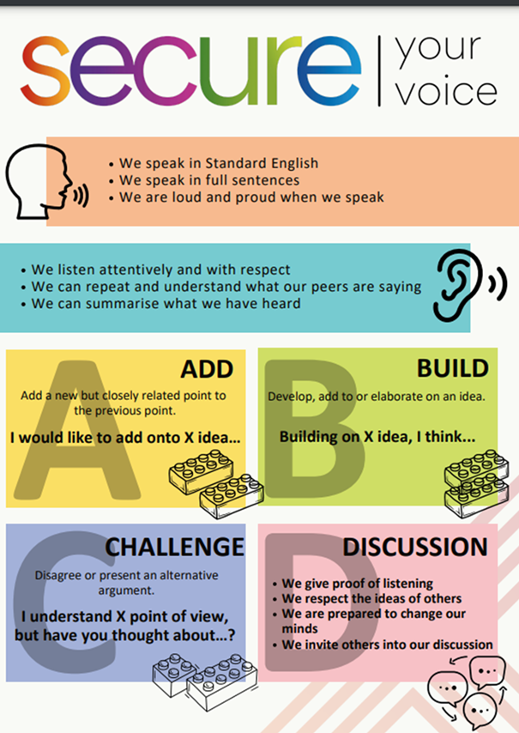
What is resilience?
Using your oracy helpsheet, discuss with the person next to you:
“What does resilience mean?”
Remember we are sharing our ideas to the class and following all the advice on the oracy helpsheet.

Slide 6
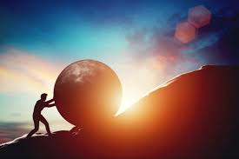
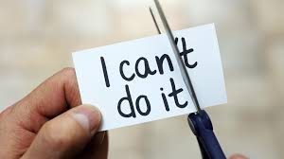
What is resilience?
The definition of resilience is…
“never giving up, working hard and going through tough times and coming out the other side”

Slide 7
Example of resilience
Everyone here has shown resilience as a baby when we learned how to walk. While watching the video think about how the baby showed resilience to eventually start to walk.

Slide 8
Example of resilience
At the beginning the baby could not even sit upright.
But they kept trying.
When they could do that they tried to stand up but fell down.
But they kept trying until they could do it.

Slide 9
Example of resilience
When they could do that they tried to move towards their parent/carer but fell down.
But they kept trying until they could do it and by the end they could walk for multiple steps

Slide 10
Why is resilience important?
Resilience helps people deal with challenges that they face in everyday life. This could be their school work, their friendships/relationships or just if they are having a tough day.

Slide 11
Why is resilience important?
Being resilient over a long period of time builds confidence and makes people mentally stronger when faced with a challenge.
This means that resilient people do not give up easily.

Slide 12
What is resilience?
Using your oracy helpsheet, discuss with the person next to you:
A time that you have found something difficult but showed resilience
Remember we are sharing our ideas to the class and following all the advice on the oracy helpsheet.

