Slide 2
Write the date: 05 November 2024
Write the title: What is democracy?
Underline both!
Complete the following questions:
How many minutes per day should young people be physically active?
What are the 2 types of sleep?
Give an example of a food classed as “protein”
60
REM and Deep Sleep
Meat, fish, eggs, beans, pulses

Slide 4
Secure your Voice: Learning Journey
What is democracy?
Political Parties in the UK
What are laws?
How did the General Election work?
What do MP’s do everyday?
What would you do as a MP?
Today we will look at:
What is democracy?
This includes:
Tutor time recap
Types of Government
Rights and responsibilities in a democracy
Protests and Petitions
Please remember that during the lesson we should not be asking any pupil or teacher personal questions.
Your teacher can ask you questions but this will be to check your knowledge in the lesson.

Slide 5
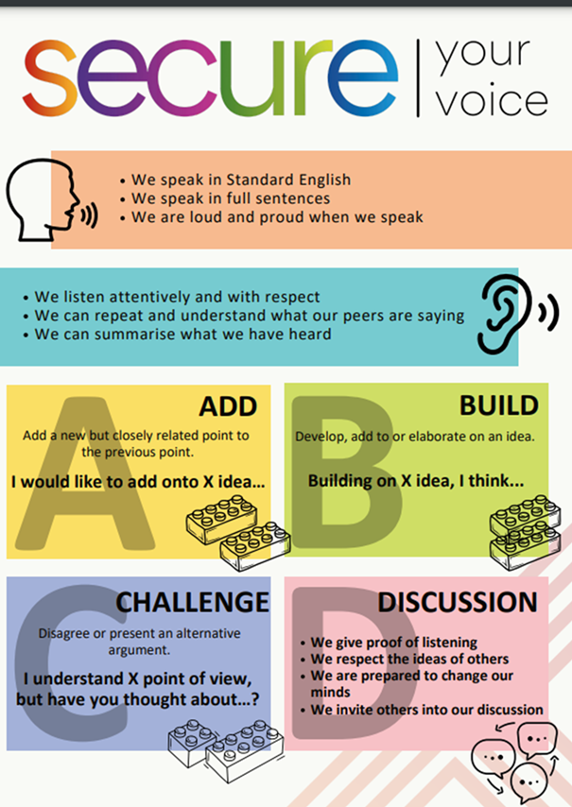
Tutor Time Recap
In tutor time this week you started to discuss democracy.
With the person next to you, what can you remember from tutor time?
Remember to listen to what your partner says and be ready to share answers with the class

Slide 6
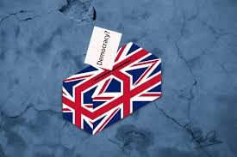
Tutor Time Recap
Democracy is “rule by the people”
Democracy is a British Value
Examples of democracy happening in the UK is our Parliament, there is Prime Minister and elected Members of Parliament and local councils. These all give people a voice on how the government is run.

Slide 7
Types of Government
There are 3 different types of Government across the world
1. Democratic Government – This is where citizens of a country vote for their leaders and there are checks and balances on power.
An example of this is the UK

Slide 8
Types of Government
There are 3 different types of Government across the world
2. Monarchy - This is where a king or queen may have symbolic power or full control.
The UK is also an example of a monarchy as there is a Royal Family. However they have limited powers of how the government is run.

Slide 9
Types of Government
There are 3 different types of Government across the world
3. Dictatorship – This is when one leader has all the power and the citizens don’t get to vote for change.
There are currently 52 countries with a dictator leader. An example of this is North Korea.

Slide 10
Hinge Questions – whiteboard activity
3
Rules!
I will ask the question and give you some thinking time. (no more than 10 seconds)
Write the answer and turn your whiteboard over so nobody can see it.
When I am ready I will put on the 3 to 1 counter.
When ‘Show me’ appears on the board you must hold up your whiteboard (even if you don’t know the answer and there is nothing on your board)
2
1
Show me!
(even if your whiteboard is blank)

Slide 11
Hinge Questions – whiteboard activity
What is being described?
“This is where citizens of a country vote for their leaders and there are checks and balances on power. ”
A – Dictatorship
B – Monarchy
C- Democratic

Slide 12
Hinge Questions – whiteboard activity
What is being described?
“This is where a king or queen may have symbolic power or full control.”
A – Democratic
B – Dictatorship
C- Monarchy

Slide 13
Hinge Questions – whiteboard activity
What is being described?
“This is when one leader has all the power and the citizens don’t get to vote for change.”
A – Dictatorship
B – Democratic
C- Monarchy

Slide 14
Rights and Responsibilities in a democracy
In a democracy, people have rights such as freedom of speech, to participate in elections and the right to protest peacefully.

Slide 15
Rights and Responsibilities in a democracy
However, with rights comes responsibility.
This means that people are responsible for:
Respecting people’s opinions if they disagree
Follow the law
Respecting people’s rights
Rights and responsibilities work together to keep society fair and safe

Slide 16
Rights and Responsibilities in a democracy
We are now going reflect on the events over the summer to see if all everyone acted responsibly to respect everyone’s rights in the UK.

Slide 17
What happened in the summer?
During the summer there were a number of protests across the country that centered around immigration.
There were protests that supported immigration and others that were against immigration.
The cause of these protests was largely due to misinformation spread online about the person who killed 3 children in Southport.

Slide 18
Hinge Questions – whiteboard activity
Decide if the description of the protest were following the rights and responsibilities of democracy
“People had the right to attend these protests regardless of their opinions ”
Yes – this is a right under democracy

Slide 19
Hinge Questions – whiteboard activity
Decide if the description of the protest were following the rights and responsibilities of democracy
“when attending the protest, people ensured they were peacefully and did not make people feel unsafe. This happens regardless if they agree or disagree with other people protesting”
Yes – this is a right under democracy. Protests must be peaceful and people must be responsible for respecting other people’s right to protest

Slide 20
Hinge Questions – whiteboard activity
Decide if the description of the protest were following the rights and responsibilities of democracy
“during the protests, some people started to shout insults at people counter protesting”
No – this is not a peaceful protest. Shouting insults can make people feel unsafe. Depending on the insult, it could also be breaking the law.

Slide 21
Hinge Questions – whiteboard activity
Decide if the description of the protest were following the rights and responsibilities of democracy
“during the protests, some people start to attack other people at the counter protest”
No – this is not a peaceful protest. This is violence and public disorder which is against the law. This is an example of people not respecting other people’s rights and acting irresponsibly.

Slide 22
Hinge Questions – whiteboard activity
Decide if the description of the protest were following the rights and responsibilities of democracy
“when attending the protests, people held up signs that insult others. However they do not say the insults out loud”
No – this is not a peaceful protest as the sign does not respect other people’s rights. It can also make people feel unsafe which means the protest is not peaceful.

Slide 23
What is the point in a protest?
Protests are a way for people to voice their opinions on issues they care about.
It is a way for people to demand change from the Government
However they are only effective when remaining peaceful. This did not happen during the summer.

Slide 24
Petitions
Another way for people to voice their opinions on issues they care about to create change is through petitions.
Petitions are when a person creates or signs a letter, statement or e-letter.
For a petition to be considered by the Government it must have 100,000 signatures

Slide 25
Examples of successful petitions
In 2020, 150,000 people signed a petition calling for laws to prevent deaths of children from damp and mouldy social housing. This followed the death of a 2 year by in Rochdale. The Government have since committed to making this law happen.

Slide 26
Examples of successful petitions
In 2015, 320,000 people signed a petition to end tax being added to female sanitary products.
This led to the cost of these products being reduced in price.

Slide 27
Petitions
However not all petitions are successful.
Over 5 million people signed a petition for the Government to reverse the Brexit decisions.
Although it was considered due to the number of signatures, no action was taken on this.

Slide 28
Petitions - task
If you could create a petition for Mrs Herrmann, SLT and Governors to consider, what would you suggest?
In your books complete the following sentences:
I would petition for…
A reason for this is…
Be ready to share your ideas for people to vote if they would sign your petition.

