Slide 2
Write the date: 11 October 2024
Write the title: importance of physical activity
Underline both!
Complete the following questions:
How much sleep should young people be getting every night?
What food group would milk be placed in?
What is resilience?
9-10 hours
Dairy and alternatives
“never giving up, working hard and going through tough times and coming out the other side”

Slide 4
Secure your Future: Learning Journey
Making new friends
Road Safety
What is resilience
Healthy food choices
Importance of sleep
Importance of physical activity
Today we will look at:
Importance of physical activity
This includes:
How much physical activity should you do?
What are the benefits of physical activity?
Please remember that during the lesson we should not be asking any pupil or teacher personal questions.
Your teacher can ask you questions but this will be to check your knowledge in the lesson.

Slide 5
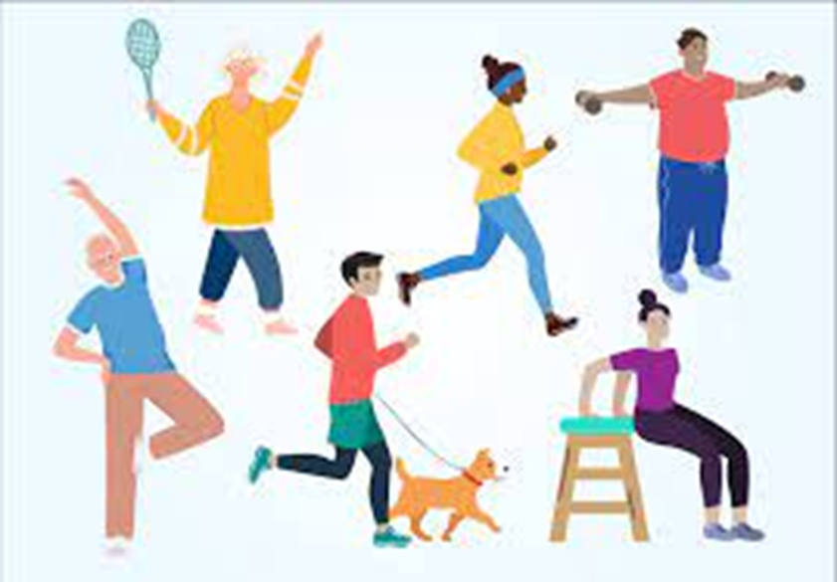
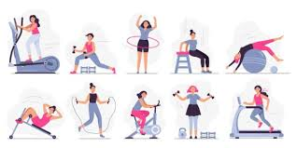
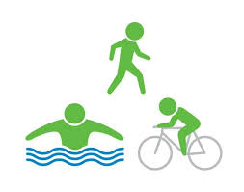
Tutor Time Recap
In tutor time this week you started to discuss the importance of physical activity.
With the person next to you, what can you remember from tutor time?
Remember to listen to what your partner says and be ready to share answers with the class

Slide 6
Tutor Time Recap
Physical activity is “any bodily movement produced by the muscles that expends energy”
Types of physical activity include playing sports, walking/cycling to school, going for a run
Where you can be physically active includes at afterschool clubs, during break times, leisure centres, parks and playgrounds

Slide 7
How much physical activity should you do?
On your whiteboards, write down how minutes of physical activity do you think young people should do every day?
Why have you given this answer?

Slide 8
How much physical activity should you do?
The World Health Organisation (WHO) states that 11-17 year olds should physical active for…
…at least 60 minutes per day of moderate to vigorous activity

Slide 9
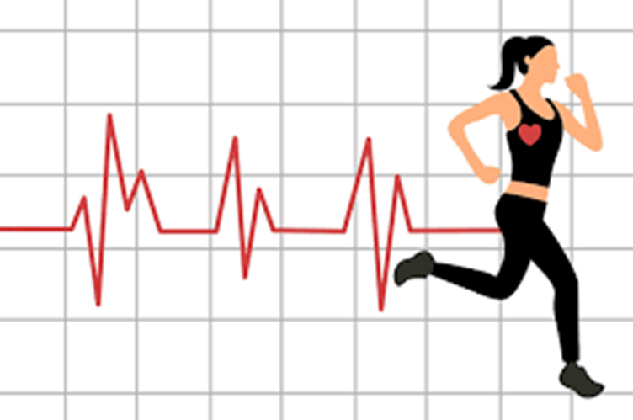
What does moderate to vigorous mean?
This is linked to your heart rate (how many times your heart beats in a minute) when you are completing physical activity.
Moderate activity = 50-60% of your maximum heart rate
Vigorous activity = 70-85% of your maximum heart rate

Slide 10
Finding out your maximum heart rate?
The calculation to find out your maximum heart rate is…
220 - age
Example
Arif is 25 years old. He wants to know if the physical activity is moderate or vigorous. He has been told he needs to figure his maximum heart rate using the calculation above.
Arif figures out that his maximum heart is 195 beats per minute

Slide 11
What is your maximum heart rate?
On your whiteboards, write down your maximum heart rate.
Depending on your age your maximum heart rate is either 208-209bpm

Slide 12
What is your maximum heart rate?
This means that in Year 7 when doing physical activity to be working at a moderate level, your heart rate has to be:
11 years old – 105 - 126 bpm
12 years old – 104 – 125 bpm

Slide 13
What is your maximum heart rate?
This means that in Year 7 when doing physical activity to be working at a vigorous level, your heart rate has to be:
11 years old – 146 – 178 bpm
12 years old – 145 – 177 bpm

Slide 14
Find your heart rate?
To find out your heart arte you need to find your pulse?
On your whiteboard write down 1 place that you can find your pulse?

Slide 15
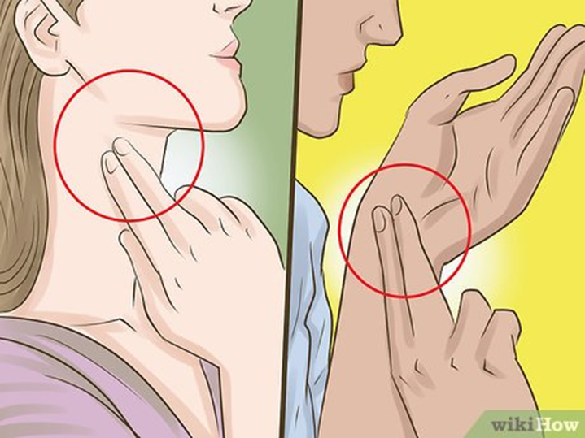
Find your heart rate?
To find your heart rate (without a smart watch or heart rate monitor) you can use your neck or wrist.
The areas are shown in the picture
Task – find your pulse now

Slide 16
Find your heart rate?
We are going to count our pulse for 30 seconds.
Now multiple the number by 2. This gives you your bpm (beats per minute)
Write down your heart rate on your whiteboard

Slide 17
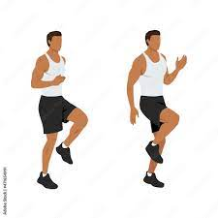
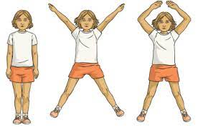
Can you get to a moderate/vigorous level
Chose either running on the spot or star jumps. You will be completing this for 1 minute.
Task – complete the chosen exercise for 1 minute.

Slide 18
Can you get to a moderate/vigorous level
Chose either running on the spot or star jumps. You will be completing this for 1 minute.
Task – Find your pulse and count for 30 seconds

Slide 19
Can you get to a moderate/vigorous level
Chose either running on the spot or star jumps. You will be completing this for 1 minute.
Task – Multiple number by 2 to get your bpm.

Slide 20
Can you get to a moderate/vigorous level
Chose either running on the spot or star jumps. You will be completing this for 1 minute.
Task – Write down the number on your whiteboard and if you were working at below moderate, moderate or vigorous level

Slide 21
Fill in the gaps
In your books, write down the following paragraph filling in the blank spaces
Physical activity is any body ___________ produced by the muscles that expends ____________. The recommended amount of physical activity for 11 – 17 years old is ____ minutes per _____. Physical activity should also be at a _________ or __________ level. Moderate level is ______ of your maximum heart rate and vigorous level is _______ of your maximum heart rate. Your maximum heart is calculated by ___________.
Word Bank
220-age
Energy
Day
Vigorous
Moderate
60
70-85%
50-60%
Movement
movement
energy
60
day
moderate
vigorous
50-60%
70-85%
220-age

Slide 22
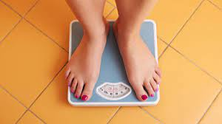
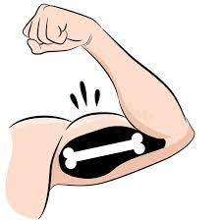
Benefits of Physical Activity
There are multiple benefits of doing physical activity. These include:
Although it is unhealthy to weigh yourself everyday, controlling your weight to a healthy level helps stop obesity, developing type 2 diabetes and reduces the risk of heart disease
Why this is important
Weight Control
This makes you stronger, it may improve your body confidence and it also reduces the risk of injury if any falls or collisions happen
Why this is important
Stronger bones and muscles

Slide 23
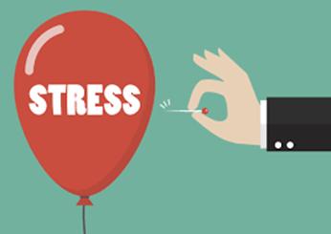
Benefits of Physical Activity
There are multiple benefits of doing physical activity. These include:
Physical activity improves your concentration levels and long term memory. This means that you will improve your grades in school
Why this is important
More Brain Power

Slide 24
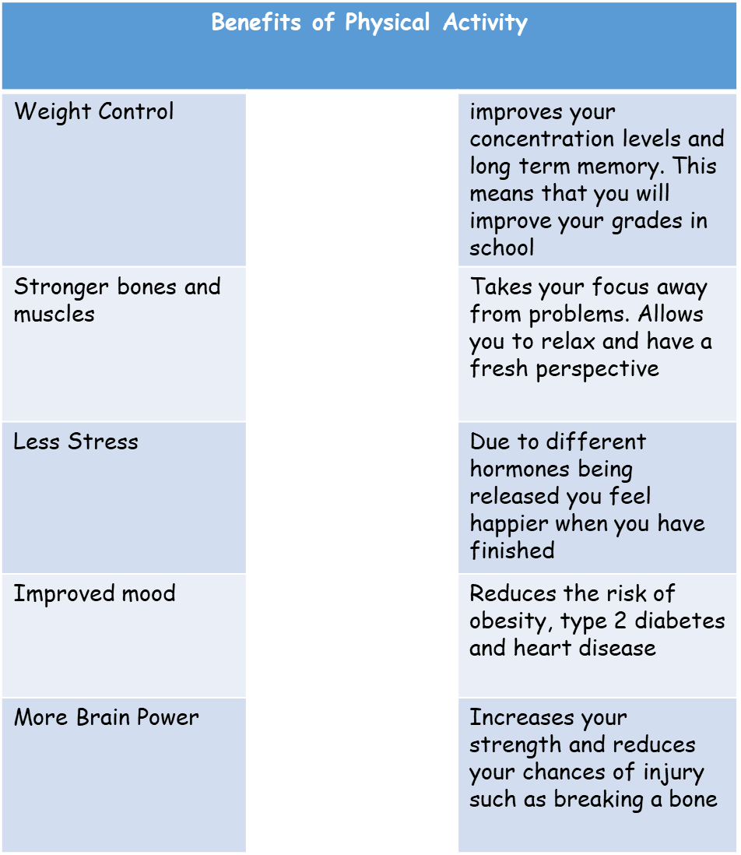
Notes:
A suggested way of doing this task is to give the whole class time to think of their answers. Choose one person to draw a line on the board. The others in the class put a tick or cross on their MWB’s if they think the person is correct. The show the correct answers on the board. The lines go in order of the benefits on the left hand side.

Slide 25
Hinge Questions – whiteboard activity
3
Rules!
I will ask the question and give you some thinking time. (no more than 10 seconds)
Write the answer and turn your whiteboard over so nobody can see it.
When I am ready I will put on the 3 to 1 counter.
When ‘Show me’ appears on the board you must hold up your whiteboard (even if you don’t know the answer and there is nothing on your board)
2
1
Show me!
(even if your whiteboard is blank)

Slide 26
Hinge Questions – whiteboard activity
True or False:
“Walking slowly to school scrolling through social media counts towards your physical activity minutes”
False – physical activity has to be at a moderate to vigorous level

Slide 27
Hinge Questions – whiteboard activity
What is the calculation to figure out your maximum heart rate?
220-age

Slide 28
Hinge Questions – whiteboard activity
True or False:
50-60% of your maximum heart counts as moderate level
True

Slide 29
Hinge Questions – whiteboard activity
True or False:
70-80% of your maximum heart counts as vigorous level
False – it is 70-85%

Slide 30
Hinge Questions – whiteboard activity
True or False:
“Playing sport is one way of being physically active”
True

Slide 31
Hinge Questions – whiteboard activity
What benefit is being described
“improve your concentration levels and long term memory. This means that you will improve your grades in school”
More brain power

Slide 32
Hinge Questions – whiteboard activity
What benefit is being described
“takes your focus away from problems and allows you to relax and have a fresh perspective”
Less stress

Slide 33
Hinge Questions – whiteboard activity
What benefit is being described
“due to different hormones being released you feel happier when you have finished”
Improved mood

Slide 34
Hinge Questions – whiteboard activity
What benefit is being described
“reduces the risk of obesity, type 2 diabetes and heart disease”
Weight Control

Slide 35
Hinge Questions – whiteboard activity
What benefit is being described
“increases your strength and reduces your chances of injury such as breaking a bone”
Stronger bones and muscles

Slide 36
Independent Task
Now that you know all about physical activity, you need to give yourself a target of how you are going to be physically active. Don’t forget you need to do a total of 60 minutes per day.
Think about how you can be physically active:
Before School
During school
After school
You should write down your target and how you are going to achieve this in your books

