Slide 2
Write the date: 05 November 2024
Write the title: What political parties are there in the UK?
Underline both using your ruler in your learning wallet. Take out your oracy helpsheet too!
Complete the following questions:
What is being described? – “rule by the people”
Give an example of how people can be physically active
How many hours of sleep do young people need every night?
democracy
Playing sport, going for a run, walking/cycling to school, walking their pet dog, going to the gym
9-10 hours

Slide 3
Secure your Voice: Learning Journey
What is democracy?
Political Parties in the UK
What are laws?
How did the General Election work?
What do MP’s do everyday?
What would you do as a MP?
Today we will look at:
Political parties in the UK
This includes:
Leaders of the political parties
manifestos
Please remember that during the lesson we should not be asking any pupil or teacher personal questions.
Your teacher can ask you questions but this will be to check your knowledge in the lesson.

Slide 4
Tutor Time Recap
In tutor time this week you started to learn about the political parties in the UK
You have 1 minute to write down 3 things you can remember from your Personal Development tutor time activity on Monday

Slide 5
Tutor Time Recap
Using your oracy helpsheet, discuss with the person next to you the things you remember from your Personal Development tutor time activity.
Remember to use the sentence starters to add, build or challenge what your partner has said.
Be ready to share your discussion with the class

Slide 6
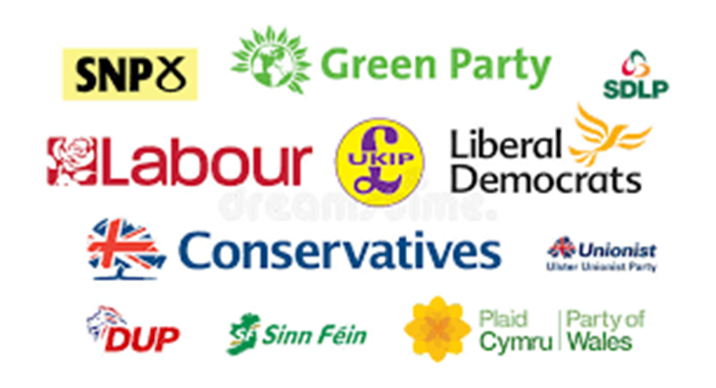
Tutor Time Recap
Political parties are “an organized group of people who share common beliefs, ideas and views about how society can develop for the benefit of everyone”
There are around 350 political parties in the UK. These include – Labour, Conservatives, Liberal Democrats, Reform UK, Green, DUP, Sinn Fein, SNP, Plaid Cymru
Not all of these political parties are represented in England. Some are only represented in the other UK countries

Slide 7
Tutor Time Recap
You are learning about this because:
Democracy is a British Value that allows rule by the people. People are free to vote for whichever political party they wish
Article 12 of the UN Rights of a Child says that governments should have respect for children’s views. Although children can’t vote, political parties still make decisions that impact children
It will also help you secure your voice by making sure you know more about the political parties ready for when you can vote at 18 years old

Slide 8
Political Party Leaders
Each political party has a “leader” and if that political party wins the most seats available in Government during a General Election, the leader of the party becomes Prime Minister of the UK
For example in the last General Election in July 2024, Labour won the most seats in the election. This meant that their leader, Sir Keir Starmer, became Prime Minister of the UK

Slide 9
Political Party Leaders
The leader of each political party has to:
Represent the party and communicate it’s ideas to the public
Work on new ideas for improving the country
Help the party members stay united behind their ideas
Be the parties main person during elections

Slide 10
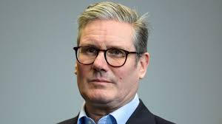
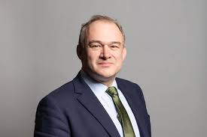
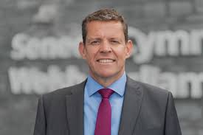
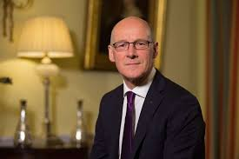
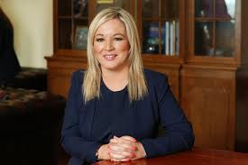
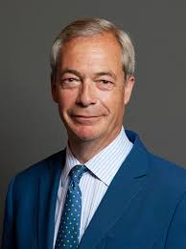
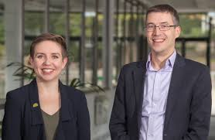
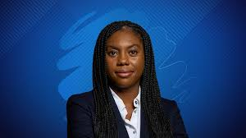
Political Party Leaders
Below are some of the political leaders in the UK. Do you know their names and what political party they represent?
Sir Keir Starmer, Labour Party
Sir Ed Davey, Liberal Democrats
Rhun ap Lorwerth, Plaid Cymru
John Swinney, SNP
Michelle O’Neill, Sinn Fein
Carla Denyer & Adrian Ramsay, Green Party
Kemi Badenoch, Conservative Party
Nigel Farage, Reform UK

Slide 11
Hinge Questions – whiteboard activity
3
Rules!
I will ask the question and give you some thinking time. (no more than 10 seconds)
Write the answer and turn your whiteboard over so nobody can see it.
When I am ready I will put on the 3 to 1 counter.
When ‘Show me’ appears on the board you must hold up your whiteboard (even if you don’t know the answer and there is nothing on your board)
2
1
Show me!
(even if your whiteboard is blank)

Slide 12
Hinge Questions – whiteboard activity
What is being described?
““an organized group of people who share common beliefs, ideas and views about how society can develop for the benefit of everyone”
Political Parties

Slide 13
Hinge Questions – whiteboard activity
What British Value is linked to today’s lesson?
A – Tolerance
B – Democracy
C- Rule of Law

Slide 14
Hinge Questions – whiteboard activity
True or False
“Article 12 of the UN Rights of a Child states that Governments should respect the views of children”
True

Slide 15
Hinge Questions – whiteboard activity
True or False
“The political party that wins the most seats during a General Election becomes the Prime Minister of the UK”
True

Slide 16
Hinge Questions – whiteboard activity
Give one role of the leader of political parties
Represent the party and communicate it’s ideas to the public
Work on new ideas for improving the country
Help the party members stay united behind their ideas
Be the parties main person during elections

Slide 17
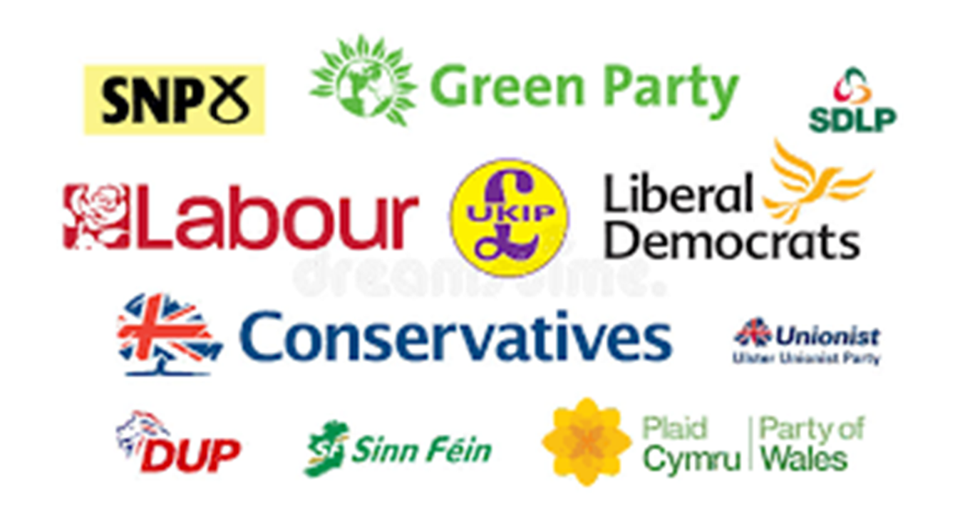
What is a political party manifesto
The definition of a manifesto is:
“a list of promises and plans that a political party creates before an election”
This means a manifesto explains what the political party plans to do if it wins the election.
Each party will have a different manifesto which reflects their own values and how they think they can improve the country. This helps votes decides which political party they support

Slide 18
Political Party Manifestos
Although all manifesto’s are different for each political party, it is likely that they will all include the following topics.
Immigration
Health
The economy
The justice system
Education
The environment
Notes:
You may want to clarify what these terms mean:
Health – this is the NHS – hospitals, local GP’s, Dentists
The Economy – how will businesses and people make more money and generate more tax to give the government money to spend
Immigration – immigration is people coming to the UK. This can happen legally and illegally
Education – how schools, colleges, universities and apprenticeships will work
The environment – how the UK will reduce their carbon emissions and tackle climate change
The Justice System – how policing, prisons and courts work

Slide 19
Manifesto
You now have 1 minute to think about the question:
“which element of a manifesto is most important to you?”
Write your reasons down in your book.

Slide 20
Manifesto
Using your oracy helpsheet, discuss with the person next to you the question:
“which element of a manifesto is most important to you?”
Remember to use the sentence starters to add, build or challenge what your partner has said.
Be ready to share your discussion with the class

Slide 21
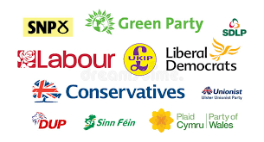
Political Party task
Working in groups you are now going to take on the role of a political party wanting to be in charge of running Hodge Hill College.
In your groups, you must:
Choose a leader
Come up with 3-5 things that would be in your manifesto
Your manifesto can include the following:
Things you would change
Things you would get rid off
Things you would introduce
Your manifesto should not include any teachers names!!!
Your leader should be ready to share their manifesto as the class will be voting on the manifesto they would choose
Notes:
Give a time limit for groups to complete the task and then ask the leader of each group to read out their manifesto
Once all groups have gone then ask for a hands up vote on the group that would be chosen

Slide 22
Leadership changes
You now have 1 minute to think about the question:
“why would a political party change their leader?”
Write your reasons down in your book.

Slide 23
Leadership changes
Using your oracy helpsheet, discuss with the person next to you the question:
“why would a political party change their leader?”
Remember to use the sentence starters to add, build or challenge what your partner has said.
Be ready to share your discussion with the class

Slide 24
Leadership changes
A political party may change their leader if:
1. A leader resigns. This could be due to not performing well during a General Election. An example of this was Rishi Sunak resigning after the Conservative Party did not win the majority of seats available at the last General Election

Slide 25
Leadership changes
A political party may change their leader if:
2. The leader loses support from other party members. An example of this is when many members of the Conservative Party wrote letters of “no confidence” about Boris Johnson. This resulted in Boris Johnson resigning

Slide 26
Leadership changes
A political party may change their leader if:
3. The party feels like it is time for a new direction. An example of this is when the Liberal Democrats changed their leader with the aim of “rebuilding their national relevance” after previous poor General Election results

Slide 27
Hinge Questions – whiteboard activity
3
Rules!
I will ask the question and give you some thinking time. (no more than 10 seconds)
Write the answer and turn your whiteboard over so nobody can see it.
When I am ready I will put on the 3 to 1 counter.
When ‘Show me’ appears on the board you must hold up your whiteboard (even if you don’t know the answer and there is nothing on your board)
2
1
Show me!
(even if your whiteboard is blank)

Slide 28
Hinge Questions – whiteboard activity
What is being described?
“a list of promises and plans that a political party creates before an election”
manifesto

Slide 29
Hinge Questions – whiteboard activity
What topics are commonly covered in a manifesto?
Health
Economy
Immigration
Education
Environment
Justice System

Slide 30
Hinge Questions – whiteboard activity
Give one reason why a political party may change their leader.
Leader resigns
Loses support of other party members
Party feels like it’s time for a new direction

