Slide 2
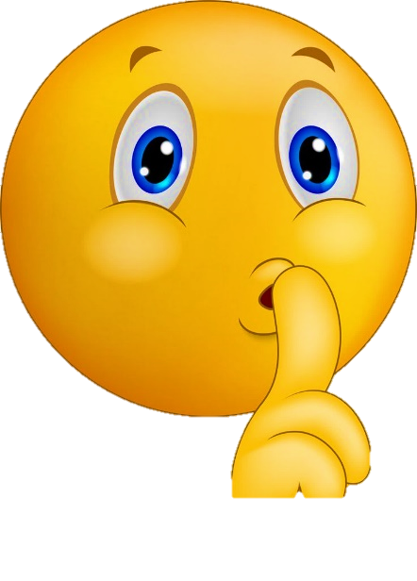
Write the date: 07 May 2024
Write the title: Stereotypes in the media
Underline both!
Complete the do now task:
What are the 3 characteristics of a unhealthy relationship?
2. What are the 3 key principles of a healthy relationship?
3. How might a person show their identity?
Disrespect, neglect and control
Respect, equity and communication
Hairstyle, fashion choices, piercing, tattoos, music choice

Slide 4
Secure your relationships: Learning Journey
What is identity?
What is a healthy relationship?
What is an unhealthy relationship?
Stereotypes in the media
Expectations of romantic relationships
What is consent?
Review
Today we will look at:
Stereotypes in the media
This includes:
What is a stereotype?
Focus on how the media portrays gender stereotypes
Please remember that we should not be asking anyone in the class or the teacher personal questions.
The teacher may ask you questions about content in the lesson but this will never be about your personal experiences.

Slide 5
What is our starting point?
In your books complete the following sentence
At the beginning of the lesson I think a stereotype is…

Slide 6
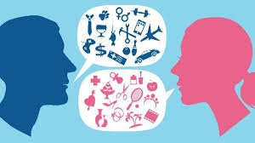
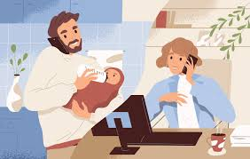
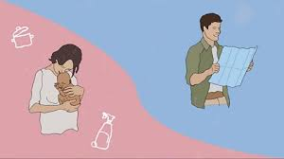
What is a stereotype?
The definition of a stereotype is…
“a mistaken idea or belief many people think about a thing or group that is based upon how they look on the outside, which may be untrue or only partly true”

Slide 7
What is a stereotype?
Some stereotypes you may have heard before are…
Girls are rubbish at science
Only boys can play football properly

Slide 8
What is a stereotype?
Think – complete the follow sentences in your book
A stereotype I have heard before is….
This stereotype is not always true because…

Slide 9
What is a stereotype?
Pair – with a partner share the sentences you have written. Can you add to the reasons of why this stereotype is not true?
Share – be ready to share your answers with the class

Slide 10
The media’s role in stereotypes
The media (magazines, websites, films etc) can often portray stereotypes particularly around gender.
Examples are:
Women are (or should be) passive and in need of protection from men. Women are most focused on emotions, relationships and fashion
Men are (or should be) strong, risk seeking and are not overly concerned or affected by emotions

Slide 11
The media’s role in stereotypes
The portrayal of these stereotypes are problematic for numerous reasons:
They are restrictive for both males and females
They are restrictive for individuals who don’t fit the stereotypes associated with their gender
They are restrictive for those people who identify as non-binary or transgender

Slide 12
Example of gender stereotyping in the media
This is an example of how the media can use gender stereotypes to sell products
Use of blue and pink to separate the male and female section of the website
Females are directed to the fashion part of the website and not the surfing aspect. This suggests they cannot surf and are only focused on fashion and how they look
Males are risk seeking as shown by the male riding the surf board. This is also the male part of the website which suggests males are not interested in fashion or how they look

Slide 13
Hinge Questions – whiteboard activity
3
Rules!
I will ask the question and give you some thinking time. (no more than 10 seconds)
Write the answer and turn your whiteboard over so nobody can see it.
When I am ready I will put on the 3 to 1 counter.
When ‘Show me’ appears on the board you must hold up your whiteboard (even if you don’t know the answer and there is nothing on your board)
2
1
Show me!
(even if your whiteboard is blank)

Slide 14
Hinge Questions – whiteboard activity
This is the definition of…
“a mistaken idea or belief many people think about a thing or group that is based upon how they look on the outside, which may be untrue or only partly true”
Stereotypes

Slide 15
Hinge Questions – whiteboard activity
Stereotypes are always 100% accurate?
A – True
B – False

Slide 16
Hinge Questions – whiteboard activity
On your whiteboards, give an example of how the media portray a female stereotype
Needs to be protected by a male, only concern about relationships and fashion

Slide 17
Hinge Questions – whiteboard activity
On your whiteboards, give an example of how the media portray a male stereotype
Needs to be strong and risk taking, not concerned about emotions

Slide 18
Stereotypes in the media task
On the left are 3 different examples of media portraying gender stereotypes. In your books complete the following sentences.
The picture I have chosen is…
This picture shows the stereotype…
Evidence of this stereotype is…
Be ready to share your answer with the class

Slide 19
Stereotypes in the media
Not all media portray stereotypical gender roles.
While watching the video think about:
How does this advert avoid any stereotypes?
How does this advert different from the images we were just discussing?
Notes:
https://www.youtube.com/watch?v=lgvCdcirG0M

Slide 20
Stereotypes in the media task
Now that you have seen a positive example of gender stereotypes in the media, look again at the images on the left.
You must now redraft an image to demonstrate a more balanced portrayal of people of different genders.
You can either redraw the image, write a list of things that should be changed, write a DM to the owner of the image to challenge the stereotypes in their post/website

Slide 21
Reflection
In your books complete the following sentence
One thing I learnt today about stereotypes is…
One way the media can portray gender stereotypes is…

