Slide 1
Remember to complete all homework tasks on SAM Learning
We still use Classcharts for announcements, surveys and revision material
Homework Club every morning in West Canteen from 8am
Library is open before school and at break times
Students on the following slides have incomplete Homework Tasks
Make sure you are completing the SET TASKS! These are the tasks your teachers have set.
Notes:
Please give time for the students to produce answers for themselves before showing answers.

Slide 3
Thought for the Day
“Practice isn’t the thing you do once you’re good. It’s the thing you do that makes you good”
Malcolm Gladwell

Slide 5
Secure your Future: Learning Journey
What is mental health?
What stress will I have this year?
What healthy habits should I start this year?
How do I manage my time effectively?
Should I have a revision timetable now?
How do I cope with different emotions?
Today we will look at:
Should you have a revision timetable now
This includes:
Importance of revision
What a good revision timetable looks like
Please remember that during the lesson we should not be asking any pupil or teacher personal questions.
Your teacher can ask you questions but this will be to check your knowledge in the lesson.

Slide 6
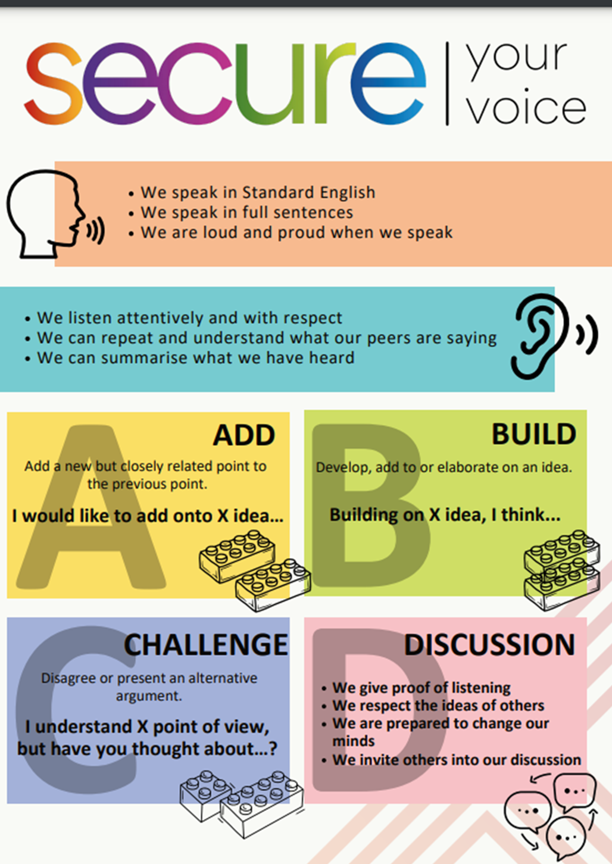
Time Management?
With the person next to you discuss the following question:
“Do you organize your revision? What do you do?
Remember to use your oracy helpsheet and be ready to share your discussion with the class

Slide 7
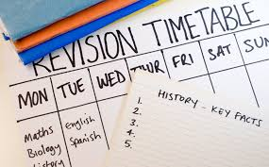
Why is revision important?
Retention – regular revision strengthens memory which helps you to retain more information
Understanding – it deepens your understanding of difficult concepts that have been taught in lessons
Confidence boost – having completed good revision means you will feel confident that you’ve covered everything and you’re ready for the exam
Reduces stress – it makes exams less daunting as the workload of revising for multiple exams has been spread out.

Slide 8
Benefits of a revision timetable
Prioritise difficult subjects – you can allocate more time to the areas where you struggle
Spread the workload – this avoids cramming everything into the days before the exam
Track your progress – this helps you to stay motivated as you tick off completed topics
Reduce anxiety – knowing what to study and when make the process less overwhelming
Better performance – people who plan their study time perform better in exams because they are more prepared and less stressed

Slide 9
Example exam timetable
List topics to revise, not subjects
Prioritise subjects that you find more difficult – these happen more often
Allocate specific times to revise topics
Schedules breaks
Mix it up – alternate between subjects to keep things interesting

Slide 10
Example exam timetable – make your own
Remember the tips:
List topics to revise, not subjects
Prioritise subjects that you find more difficult – these happen more often
Allocate specific times to revise topics
Schedules breaks
Mix it up – alternate between subjects to keep things interesting
Revision timetable
Time | Monday | Tues | Wed | Thurs | Fri | Sat | Sun

Slide 11
Revision timetable
Time | Monday | Tues | Wed | Thurs | Fri | Sat | Sun

