Slide 1
Remember to complete all homework tasks on SAM Learning
We still use Classcharts for announcements, surveys and revision material
Homework Club every morning in West Canteen from 8am
Library is open before school and at break times
Students on the following slides have incomplete Homework Tasks
Make sure you are completing the SET TASKS! These are the tasks your teachers have set.
Notes:
Please give time for the students to produce answers for themselves before showing answers.

Slide 2
Complete all tasks with a due date of 21st October onwards
11eTg1
Alahmad, Zakaria
Calin, Sebastian
Iqbal, Eesa
Khan, Farhan
Mehmood, Ehteshaam
O'Brien, Tammy
Vo, Nancy
Zadeh, Sanyar
Notes:
Please give time for the students to produce answers for themselves before showing answers.

Slide 3
11eTg2
Complete all tasks with a due date of 21st October onwards
Ahmad, Mohammed
Ali, Muhammed
Hasan, Ahmad
Ibrahim, Abdul-Kareem
Idrees, Safaa
Iqbal, Haris
Massadiq, Amreen
Qaiser, Rehan
Shafiq, Mohammed
Usman, Maneebah
West-Hall, Kalice
Notes:
Please give time for the students to produce answers for themselves before showing answers.

Slide 4
11eTg3
Complete all tasks with a due date of 21st October onwards
Babiker, Omer
Botofei, Claudio
Choudhury, Mahi
Khan, Asma
Khan, Hawa
Latiff, Usaamah
Meadley, Nickeisha
Naveed, Aleyna
Shoukat, Mohammed
Waseem, Zakir
Notes:
Please give time for the students to produce answers for themselves before showing answers.

Slide 5
11eTg4
Complete all tasks with a due date of 21st October onwards
Hosseinpour, Beniamin
Khalid, Amaan
Khan, Hafsa
Khizar, Mehvish
Mahmood, Safyan
Majid, Raheem
Mohammad, Badrin
Mohammad, Salem
Osman, Eisa
Notes:
Please give time for the students to produce answers for themselves before showing answers.

Slide 6
11eTg5
Complete all tasks with a due date of 21st October onwards
Bashir, Yusuf
Iftikhar, Aseem
Iqra, Aleeza
Margean, Sebastian
Muhammad, Alyaan
Muhammad, Usman
Qasim, Muhammadh
Rahman, Maysoon
Notes:
Please give time for the students to produce answers for themselves before showing answers.

Slide 7
Complete all tasks with a due date of 21st October onwards
11wTg1
Ahmed, Alayna
Ali, Mohammed
Atiq, Zunairah
Bouriz, Lamis
Ceesay, Abu
Coley, Ammaara
Diop, Malik
Khalid, Haroon
Mahmood, Aymaan
Meadley, Olivia
Mohamed, Abdirahman
Mumtaz, Mustafa
Nabi, Rayyan
Rehan, Muhammad
Ullah, Ehsan
Wahid, Raeece
Notes:
Please give time for the students to produce answers for themselves before showing answers.

Slide 8
Complete all tasks with a due date of 21st October onwards
11wTg2
Ahmed, Tauqeer
Azer, Eshaal
Begum, Hana
Begum, Maria
Bolmadir, Marta
Deen, Mohammed
Farhan, Muhammad
Ghani, Mohammed
Haseeb-Ul-Hassan, Muhammad
Hassan, Harris
Hussain, Aaryan
Tabrez, Zahraa
Zaheer, Zaki
Notes:
Please give time for the students to produce answers for themselves before showing answers.

Slide 9
Complete all tasks with a due date of 21st October onwards
11wTg3
Hoor, Alina
Idrees, Fatima
Jaleel, Arij
N'guessan, Jacob
Rahman, Farhan
Rehman, Yusuf
Said, Younas
Saleem-Din, Rahaan
Zamir, Ismaeel
Zulfqar, Adam
Notes:
Please give time for the students to produce answers for themselves before showing answers.

Slide 10
Complete all tasks with a due date of 21st October onwards
11wTg4
Abdi, Zak
Bashir, Muhammed
Bi, Sarah
Connop, Jayden
Fizza, Momina
Hussain, Muhammad
Lalloo, Zoya
Rostas, Armando
Sara, Suraya
Notes:
Please give time for the students to produce answers for themselves before showing answers.

Slide 11
Complete all tasks with a due date of 21st October onwards
11wTg5
Ahmed, Ahsan
Akbar, Nayeeb
Ali, Hussain
Atisam, Muhammad
Choudhury, Alisha
Imran, Ismail
Iqbal, Danish
Kabir, Alina
Kausar, Mehek
Khan, Imaan
Khan, Musa
Muhammed, Rayhaan
Noor, Fahima
Zaman, Sabah
Notes:
Please give time for the students to produce answers for themselves before showing answers.

Slide 13
Thought of the Day
“We are stronger together. In a democracy, every voice matters”

Slide 15
Secure your Future: Learning Journey
What is democracy?
Political Parties in the UK
What are laws?
How did the General Election work?
What do MP’s do everyday?
What would you do as a MP?
Today we will look at:
What is democracy?
This includes:
Definition of democracy
Democracy in the UK
Quiz
Please remember that during the lesson we should not be asking any pupil or teacher personal questions.
Your teacher can ask you questions but this will be to check your knowledge in the lesson.

Slide 16
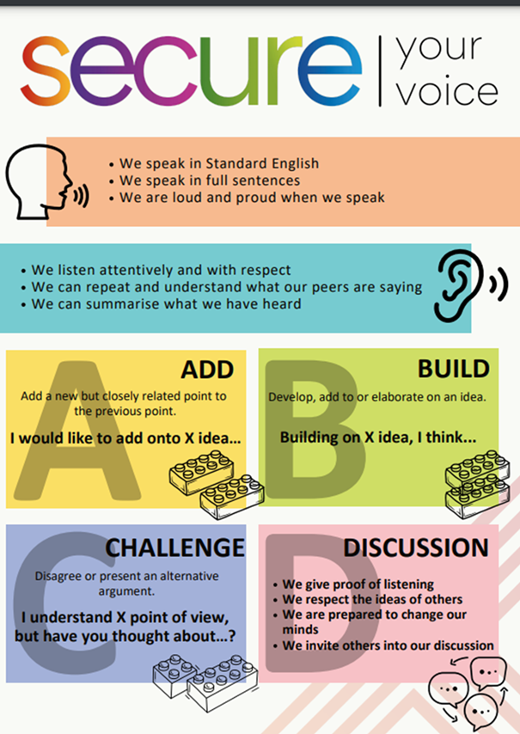
What is democracy?
Using your oracy helpsheet, discuss with the person next to you:
“What is democracy? Where have you heard the term before?”
Remember we are sharing our ideas to the class and following all the advice on the oracy helpsheet.

Slide 17
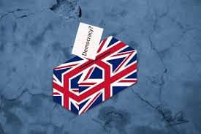
What is democracy?
Democracy is..
“rule by the people”
This means that in countries that follow democracy, the people elect the government and have a say in how the country is run.
This means that it is a fair system that ensure everyone in that country has a voice

Slide 18
What is democracy?
Watch the video to learn more about democracy
Notes:
https://www.youtube.com/watch?v=u6jgWxkbR7A

Slide 19
Democracy in the UK
Democracy is a British Value.
This means in the UK there is a culture built upon freedom and equality, where everyone is aware of their rights and responsibility.
This is why British Values, URC Children Rights and Protected Characteristics are included in our news discussions in Tutor Time.

Slide 20
Democracy in the UK
Examples of democracy in the UK:
1. Parliament – The UK has a Parliament with 2 houses – the House of Commons and the House of Lords. They are responsible for lots of things but they also help to make laws that keep everyone in the UK safe

Slide 21
Democracy in the UK
Examples of democracy in the UK:
2. Prime Minister – The leader of the Government is the Prime Minister. This is the leader of the political party that has the most Members of Parliament (MPs)

Slide 22
Democracy in the UK
Examples of democracy in the UK:
3. Members of Parliament (MP’s) – These are people elected to represent their local areas (called constituencies) in the House of Commons

Slide 23
Democracy in the UK
Examples of democracy in the UK:
4. Local Councils – In addition to national government, there are local councils that make decisions for the towns and cities within their council area. Members of the council are also elected.

Slide 24
Hinge Questions – whiteboard activity
3
Rules!
I will ask the question and give you some thinking time. (no more than 10 seconds)
Write the answer and turn your whiteboard over so nobody can see it.
When I am ready I will put on the 3 to 1 counter.
When ‘Show me’ appears on the board you must hold up your whiteboard (even if you don’t know the answer and there is nothing on your board)
2
1
Show me!
(even if your whiteboard is blank)

Slide 25
Hinge Questions – whiteboard activity
What democratic votes happened this year in the West Midlands?
Local council votes including electing the Mayor of West Midlands
General Election to vote on what political party runs the Government

Slide 26
Hinge Questions – whiteboard activity
Who is the Mayor of West Midlands?
Richard Parker

Slide 27
Hinge Questions – whiteboard activity
What political party is in charge of the government?
Labour

Slide 28
Hinge Questions – whiteboard activity
Who is the UK Prime Minister?
Sir Keir Starmer

Slide 29
Hinge Questions – whiteboard activity
Who was the previous UK Prime Minister?
Rishi Sunak

Slide 30
Hinge Questions – whiteboard activity
Where are the Houses of Parliament in the UK?
Westminister, London

Slide 31
Hinge Questions – whiteboard activity
Where does the Prime Minister live in London?
10 Downing Street

