Slide 2
Secure your Future: Learning Journey
What is mental health?
What is stress?
Hope to cope with stress?
What healthy habits should I have this year?
How can I manage my time effectively?
Should I have a revision timetable now?
Today we will look at:
What is stress?
This includes:
Definition of stress
What impacts stress can have
What is positive stress?
Please remember that during the lesson we should not be asking any pupil or teacher personal questions.
Your teacher can ask you questions but this will be to check your knowledge in the lesson.

Slide 3
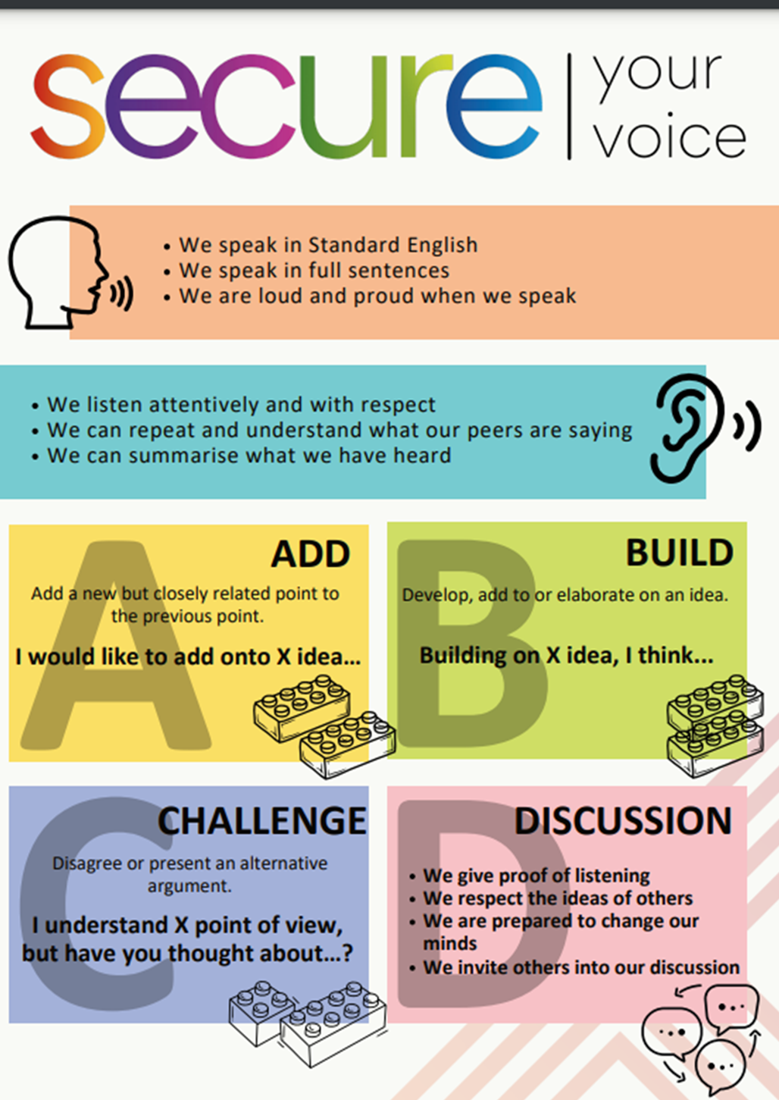
What is stress?
With the person next to you discuss the following question
“what is stress? Where have you heard the term stress before?”
Be ready to share your discussion with the class

Slide 4
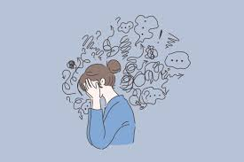
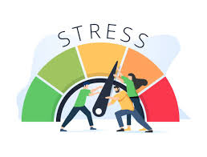
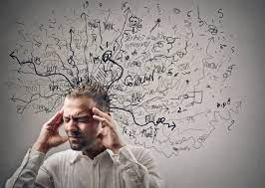
What is stress?
The definition of stress is…
“a normal reaction to the demands in our lives. It is a response to events in life when your brain releases hormones for the fight, flight or freeze response”

Slide 5
What is stress?
Flight, fight or freeze is the bodily response to stress.
Flight – the body wants to escape from the situation
Fight – the body is prepared to take action against the demand
Freeze – the body and mind are overwhelmed by the situation and do not react to the situation

Slide 6
Effects of stress?
Stress can have an effect on feelings, thoughts, the body and behaviour choices. With the person next to you match up the effect and definition
Feelings
This can make people choose between flight, fight or flight
Thoughts
This can make people have an increased heart rate, dilated pupils and faster breathing
Body
This can make people frightened and scared
Behaviour choices
This can make people feel inadequate and confused

Slide 7
Effects of stress
All of these effects are responses to negative stress.
Negative stress is a kind of stress that described situations that make people feel overwhelmed and feel that they do not have the ability to cope with the demands being placed on them.

Slide 8
Effects of stress
However not all stress is negative. There is such as thing as positive stress.
Positive stress is a kind of stress that helps motivate people to do well, challenge themselves and become energized to accomplish the tasks they have been given.
With your partner discuss some situations that could be described as positive stress

Slide 9
Managing stress
While watching the video answer the following question:
What ways can stress be managed?
Notes:
https://www.youtube.com/watch?v=hnpQrMqDoqE

Slide 10
Support
If you ever need support about stress for either yourself or a friend/family member, you can get support from the following places
Childline.org.uk
Call – 08001111
Email or chat online for support
Themix.org.uk
You can email or have one-to-chat online.
There is also a crisis messenger which is available 24/7

